Slide 1


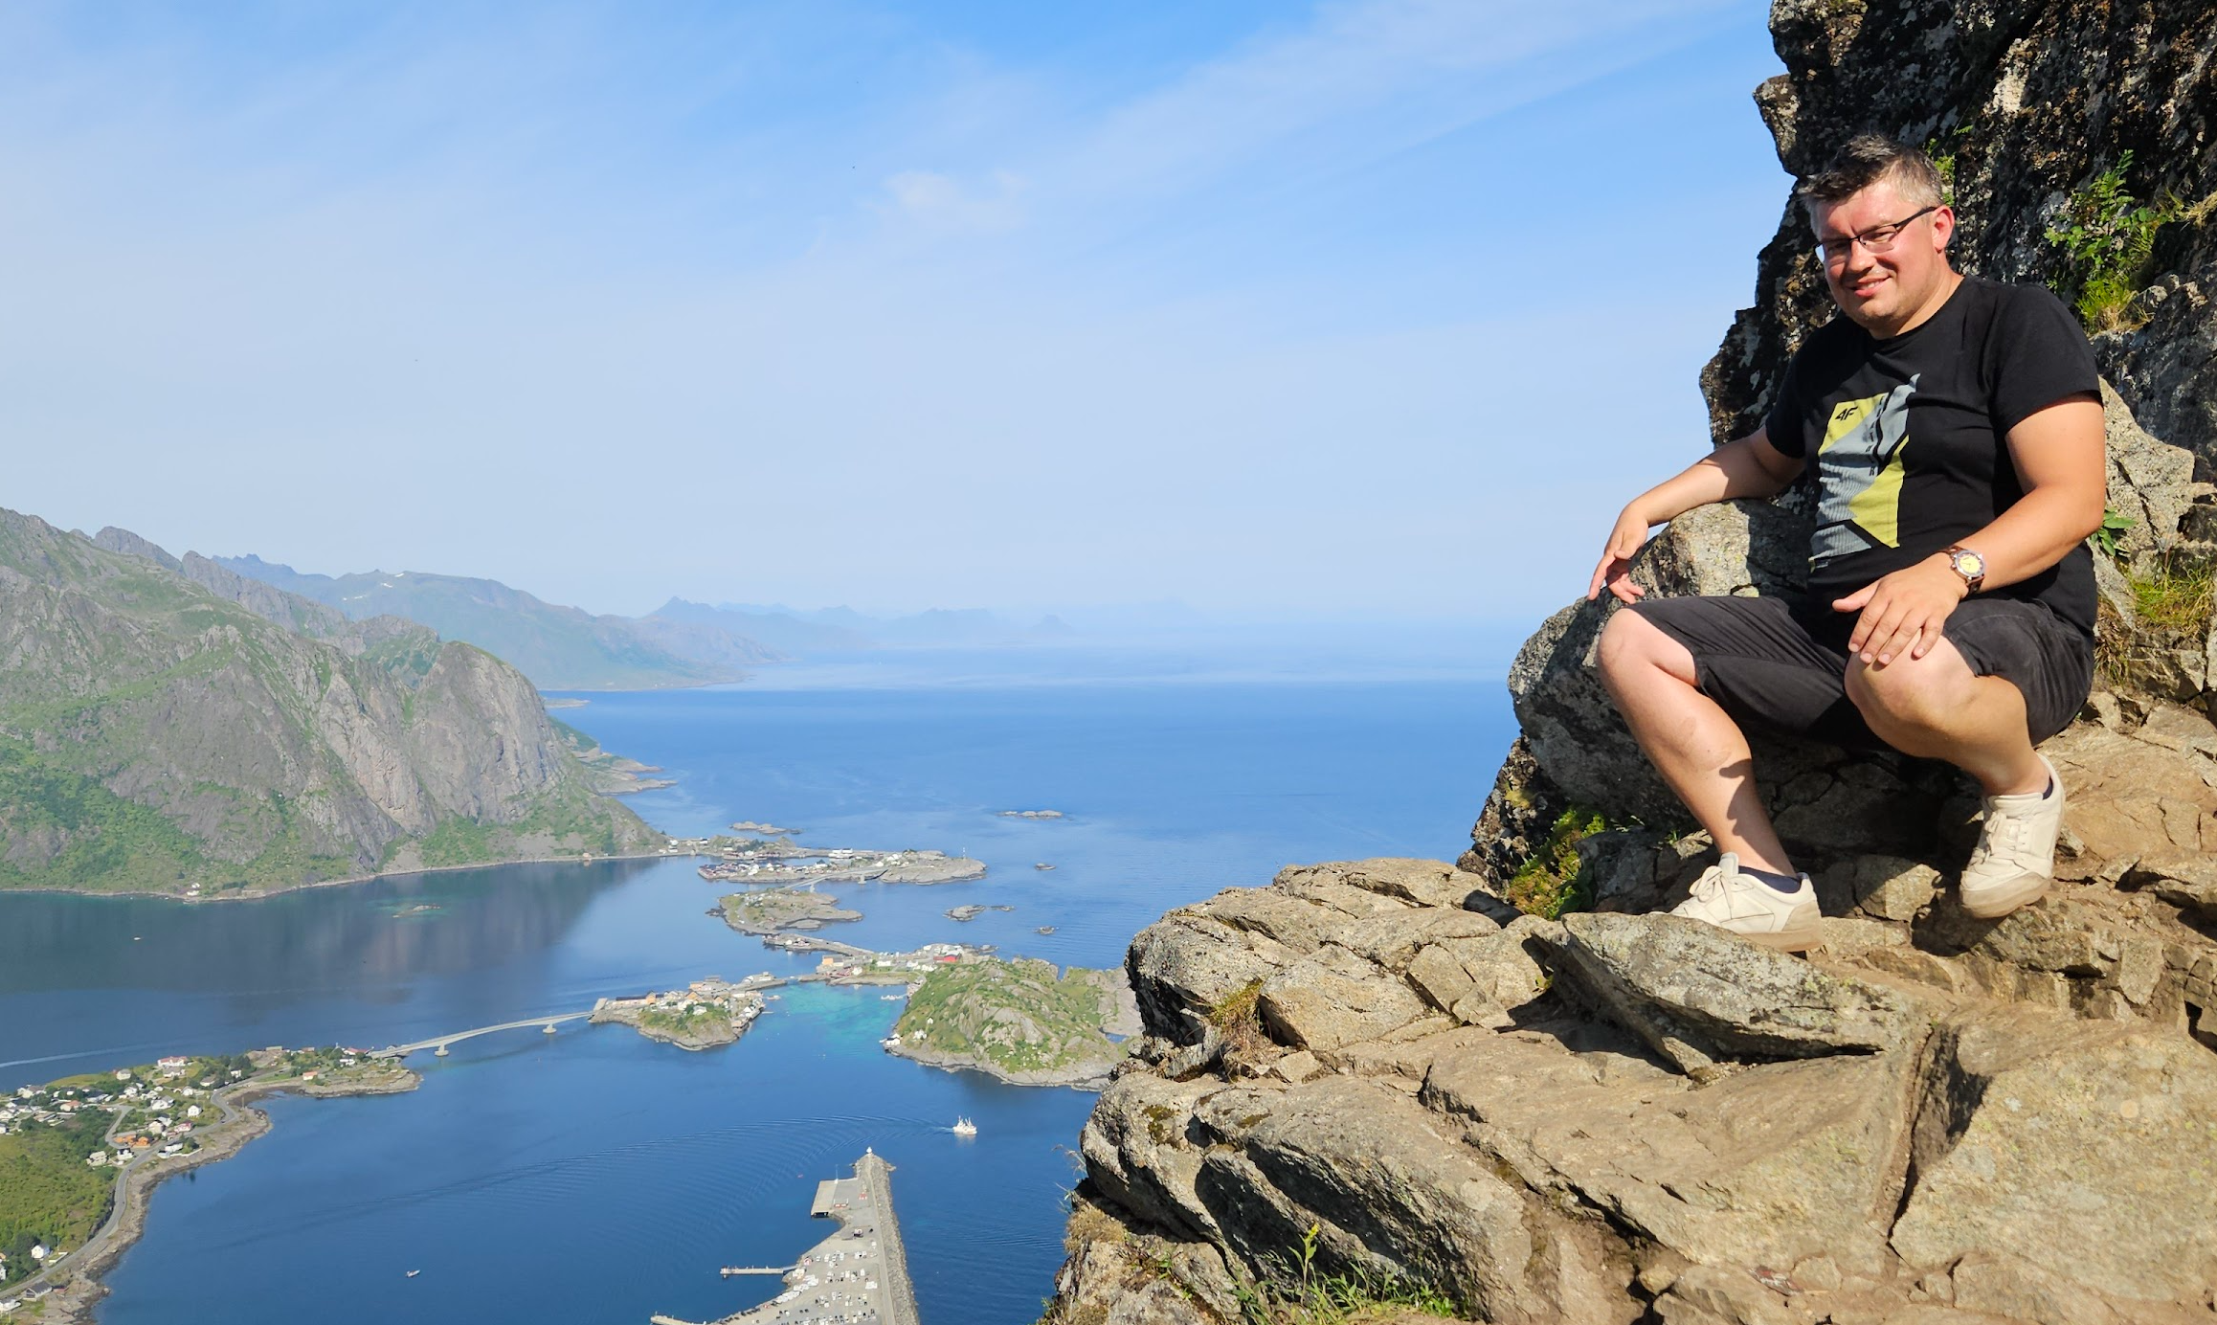



Poland - The most exciting emerging market
Jan Jakubaszek
jan.jakubaszek@przezmorze.pl
+48 502-205-208

Slide 2
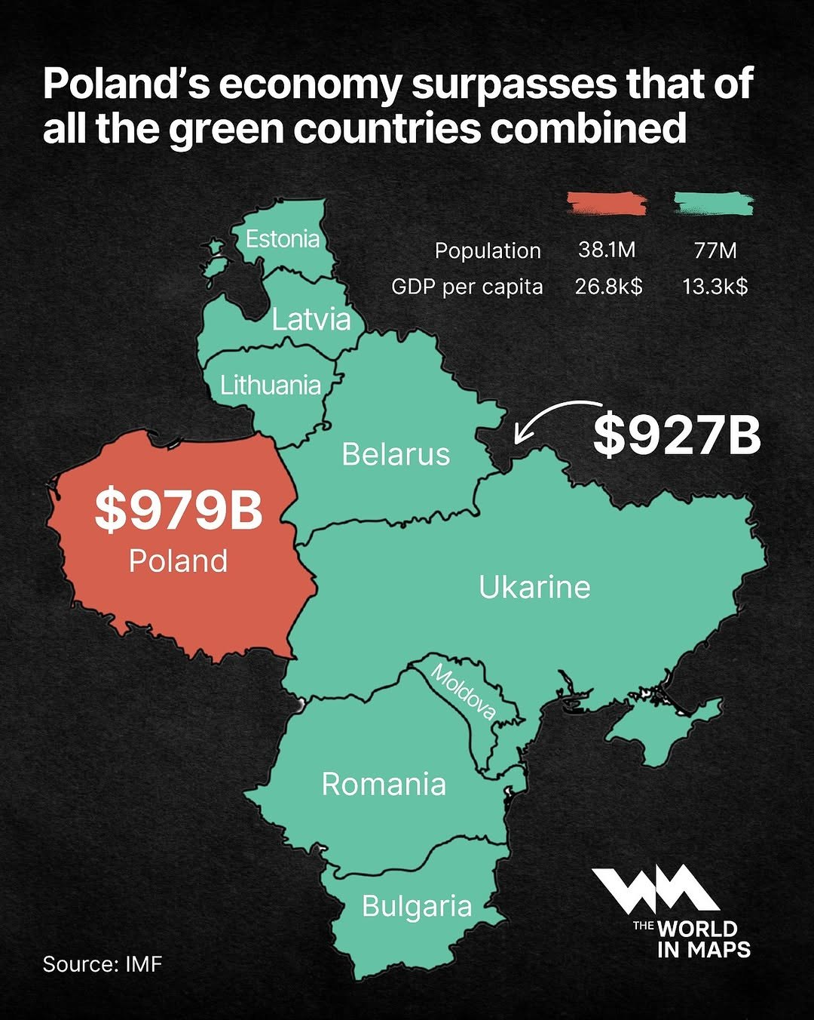
Polish economy 20th place in the global ranking
According to the IMF, Poland's GDP will increase to $0.98 trillion from $0.91 trillion in 2025, allowing it to overtake Switzerland and jump to 20th place in the global ranking.
GDP in current prices in b US dolars
2005 – 225 b USD
2024 – 910 b USD
37+ million citizens
2.6% unemployment rate
According to Eurostat, the unemployment rate in Poland in February 2025 was 2.6 percent and was the lowest in the EU

Slide 3
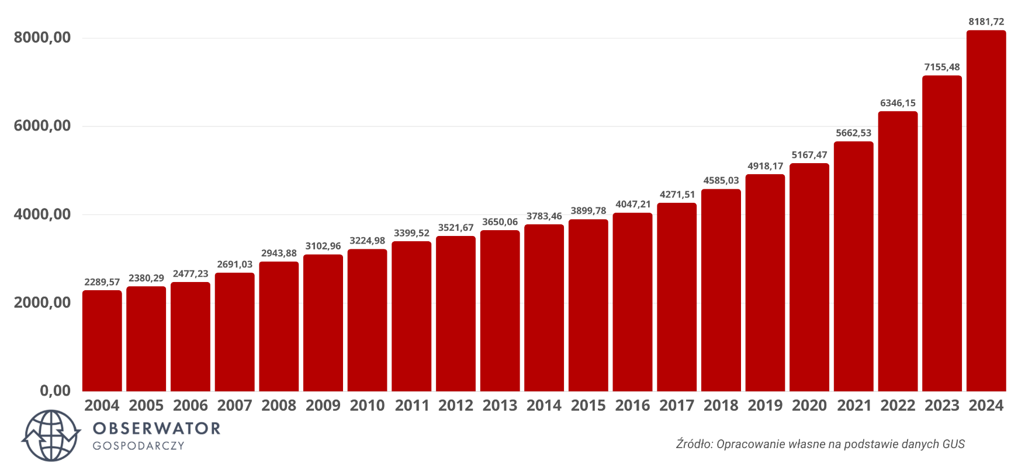
Polish economy - we can afford more
The average monthly salary from 2004 increased by approximately 257%.
In terms of purchasing power, our average salary has increased by 90% over the last 20 years.
Average monthly salary over the years
The real increase in average wages in 2024 was record:
9,5% (after taking into account inflation)
Over the last 5 years, the average salary in Poland has increased by 66%

Slide 4
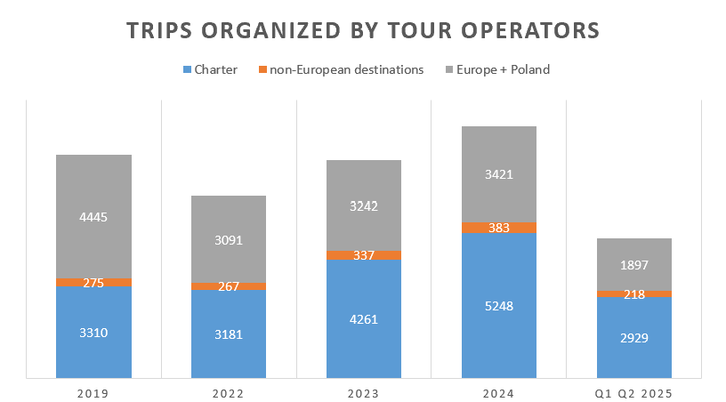
Polish tour operator market
In 2025, we will exceed 10 million tourists using organized trips provided by tour operators
58% - charter
4% - non-European countries
38% (around 4 mln tours 2025)
Poland and European countries using a means of transport other than charter flights
8 mln 6,5 mln 7,8 mln 9 mln Q1 Q2 5 mln

Slide 5
Polish tour operator market
Currently, we have over 5,300 registered tour operators with active insurance coverage in Poland. This number is constantly growing.

Slide 6


Przezmorze group
Przezmorze.pl is a leading wholesale supplier in the Polish tour operator market, specializing in ferry and hotel packages to Scandinavia.
Powered by a proprietary B2B platform, the company streamlines calculations, bookings, execution, and settlements. Tour operators can access ready-made packages that combine services from multiple providers or create and price their own tailor-made programs.
Przezmorze.pl is continuously seeking new suppliers to expand and diversify its offer.

Slide 7


Przezmorze B2B wholesaler
Goals
Results 2023 2024 2025 2026
Groups 224 416 700 1000+
Tourists 11 000 20 500 33 000 45 000+
Pax/nights 45 000 75 000 130 000 180 000+
Turnover 3,1 M eur 4,45 M eur 8 M eur 12 M eur
Jan Jakubaszek
jan.jakubaszek@przezmorze.pl
Your partner on the Polish market

