Slide 1
European Tourism Export Forum
www.etoa.org
Notes:
Right click -> Format Background -> Replace it with your picture ☺

Slide 2
ROW
www.etoa.org
Notes:
Right click -> Format Background -> Replace it with your picture ☺

Slide 3
“Europe” is a destination
People are attracted by individual cities and countries
These are the components of a “European” Trip
www.etoa.org
Notes:
Right click -> Format Background -> Replace it with your picture ☺

Slide 4
“Europe” has global reach
Vast Cultural Footprint
Seen as “European”
Art, Music, Dance
Political, legal and commercial norms
Industrial processes
All acts as a “pan European” draw
European diaspora also seen as “coming home”
www.etoa.org
Notes:
Right click -> Format Background -> Replace it with your picture ☺

Slide 5
Melting Pot
European diaspora
Now has shared ancestry
Biden – part English, part Irish, part Frence
Trump – part German, part Scottish
George Washington – part English, part Swedish
A shared European heritage a defining characteristic of US Presidents
www.etoa.org
Notes:
Right click -> Format Background -> Replace it with your picture ☺

Slide 6
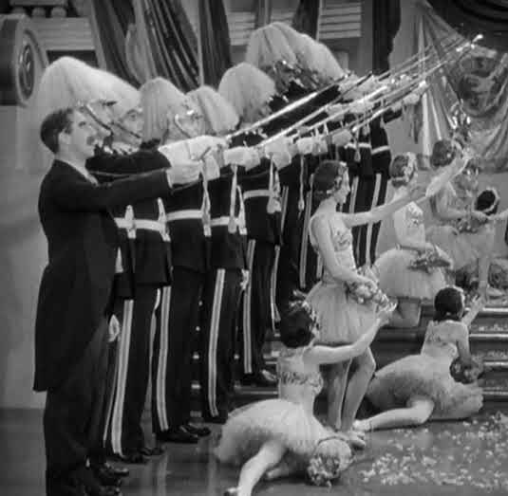
Europe – Unique appeal
Small Countries
- packed into small area
Huge Cultural diversity
Constant variation in interest
Spectacular contrasts
Innsbruck in the morning
Venice in the Afternoon
www.etoa.org
Notes:
Right click -> Format Background -> Replace it with your picture ☺

Slide 7
European Travel Commission
ETC was founded to aid
“the joint development of Europe as one tourist area, so that Europe’s trade with other continents, especially with the American continent, may result in the maximum possible gain in foreign exchange. “
www.etoa.org
Notes:
Right click -> Format Background -> Replace it with your picture ☺

Slide 8
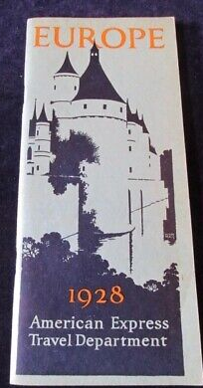
ETOA
Founded by operators who sold Europe
Europe – as a product
has a long history
big present
G2 reported that outbound group traffic from
Indonesia was 95% multi country
Thailand was 70% multi country.
South Korea around 60% multi-country.
Enormously helped by the Schengen Visa
www.etoa.org
Notes:
Right click -> Format Background -> Replace it with your picture ☺

Slide 9
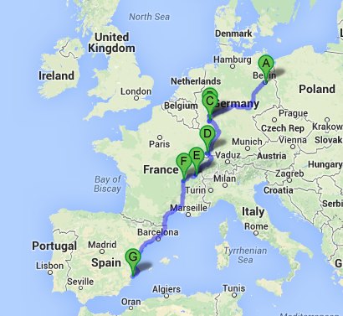
Number of countries
Estimates of the average visitor
US – 2.3 countries
Japan - 1.9 countries
China – 2.2 countries
For first time visitors the proportion will be higher
These are precisely those that we want to attract
www.etoa.org
Notes:
Right click -> Format Background -> Replace it with your picture ☺

Slide 10
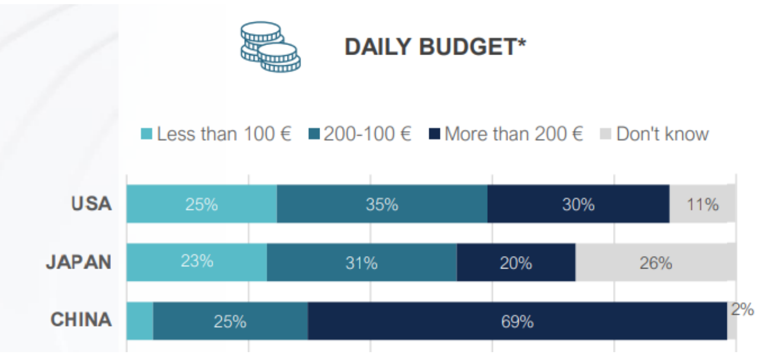
Long-haul traveller expenditure

Slide 11
Spending Power
Equivalent of someone with $130,000 income
- all export revenue
Huge contribution to destination economies
www.etoa.org
Notes:
Right click -> Format Background -> Replace it with your picture ☺

