Slide 1
Taking stock and looking beyond

Slide 2
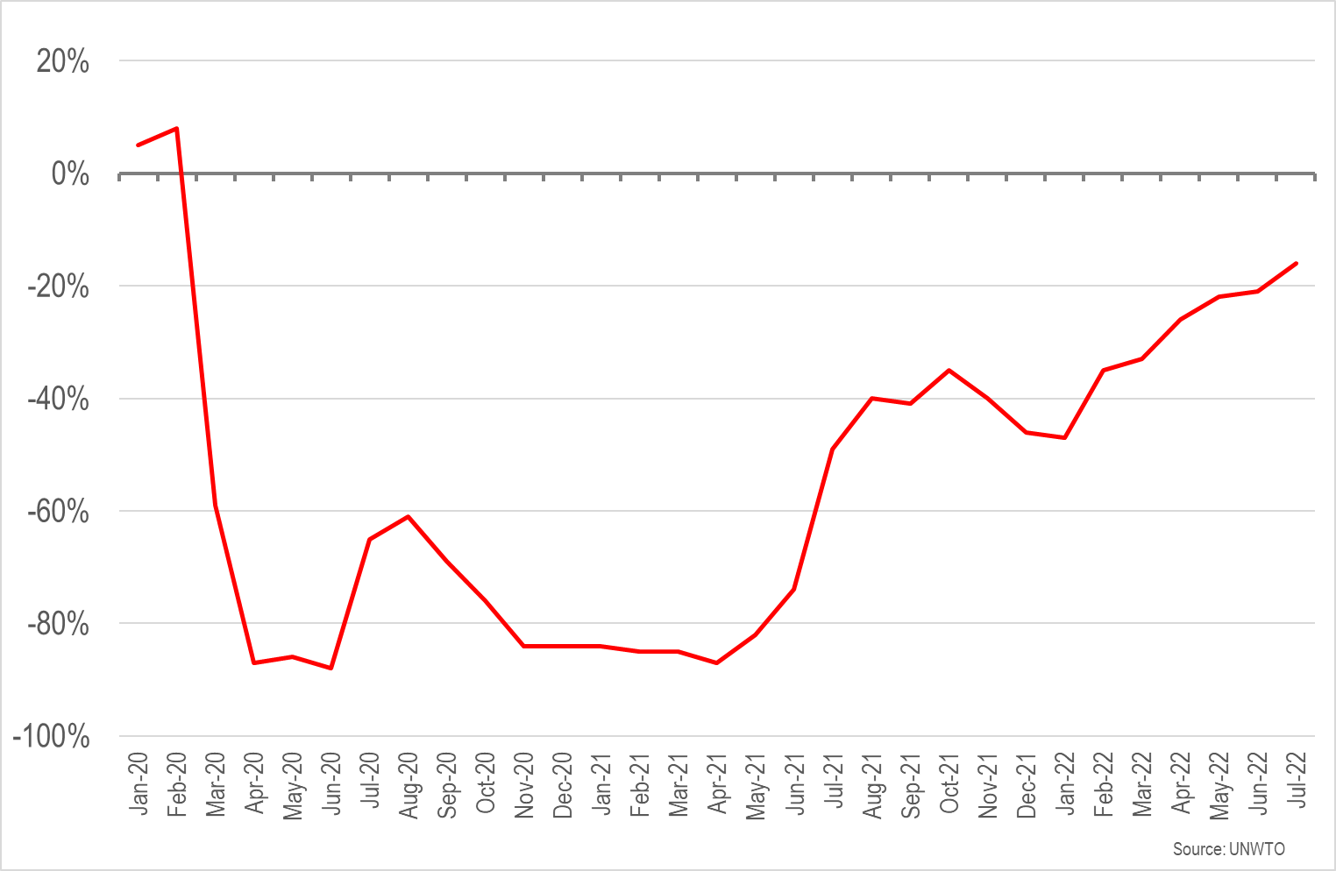
International arrivals in Europe compared with 2019
The shortfall was just 16% in July

Slide 3
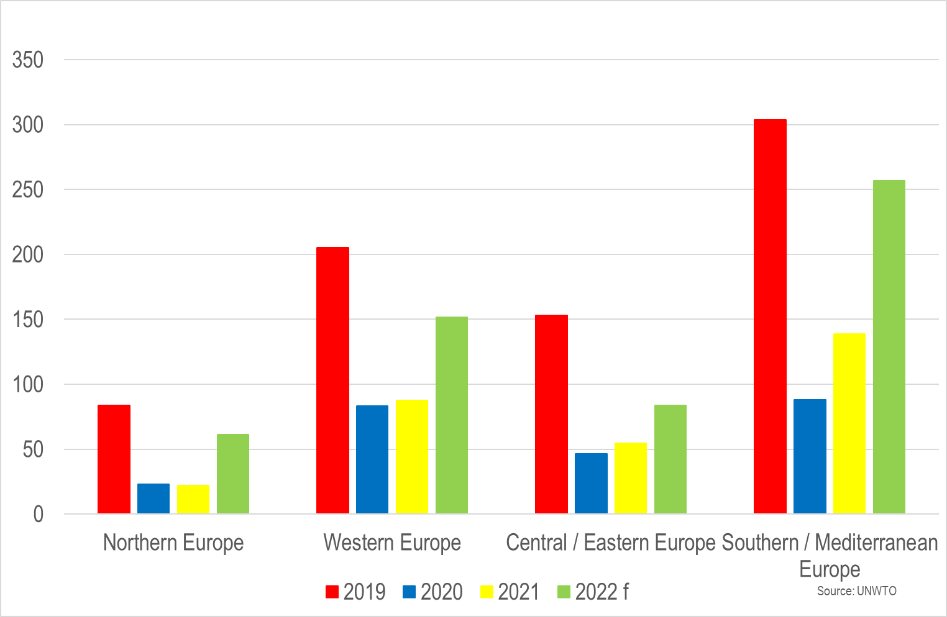
International arrivals in Europe’s regions (millions)
2022 forecast assumes year-to-date performance will apply across the full year, in reality Q4 should outperform Q1

Slide 4
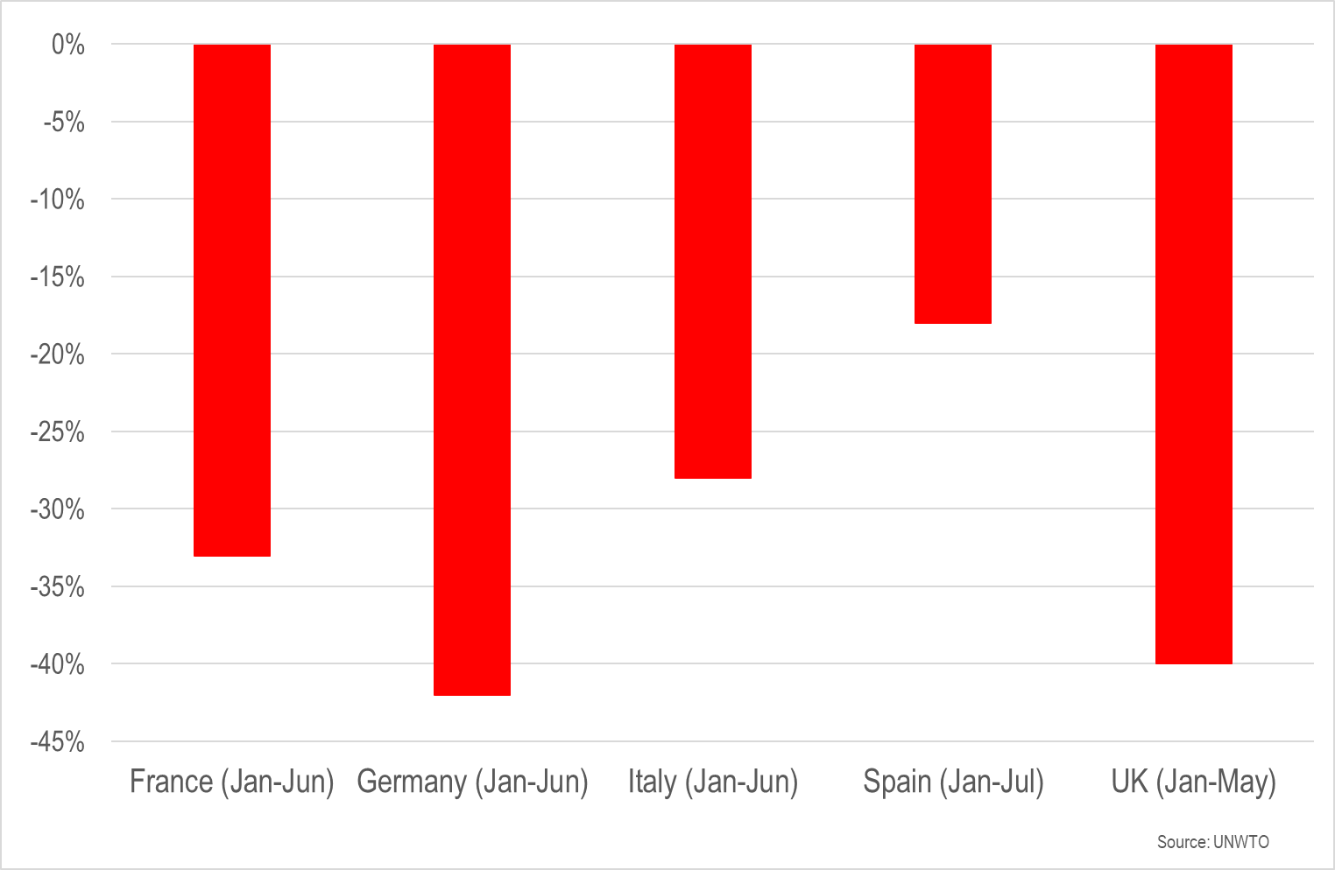
International arrivals in selected destinations (year-to-date)

Slide 5
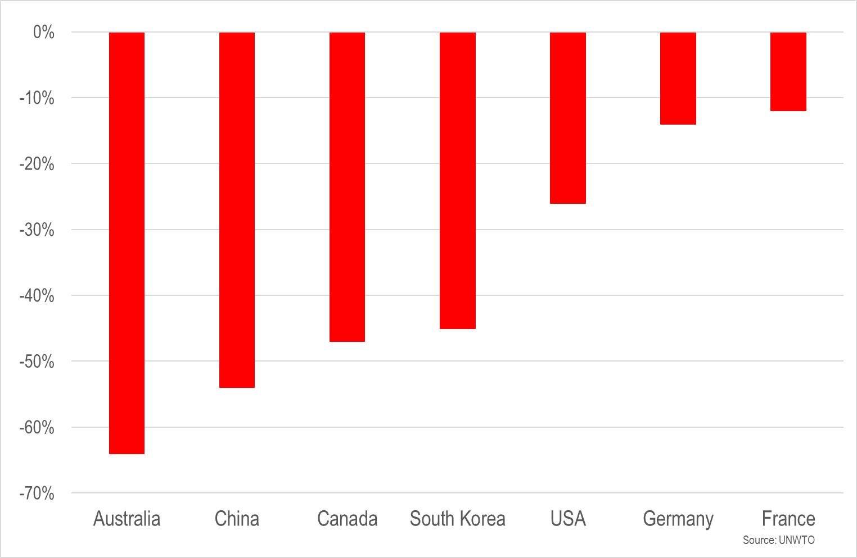
Spend on outbound travel compared with 2019 (year-to-date)
The wave of pent-up demand from some markets may have already reached the shore, but that from other markets remains far out at sea

Slide 6
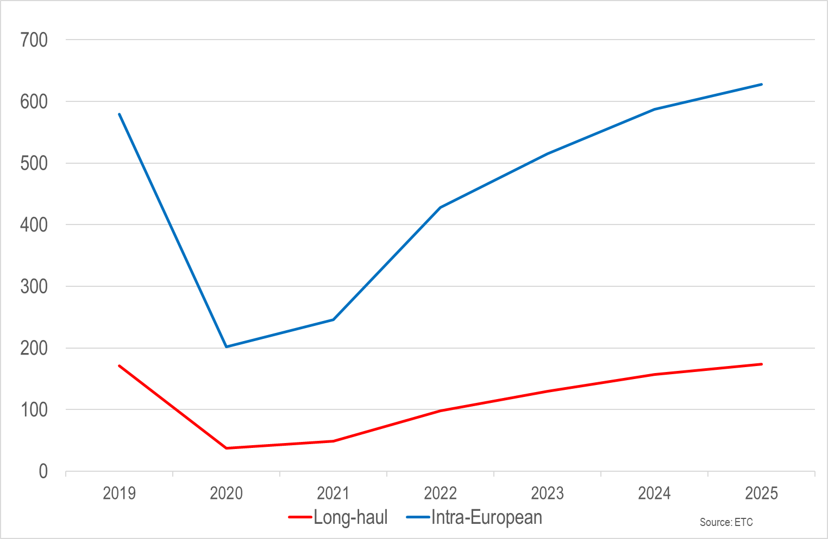
International arrivals in Europe: trends and forecasts (millions)
Full recovery is still forecast to be two to three years away
Volume is dominated by short-haul, but long-haul visitors typically spend two to three times as much per visit

Slide 7
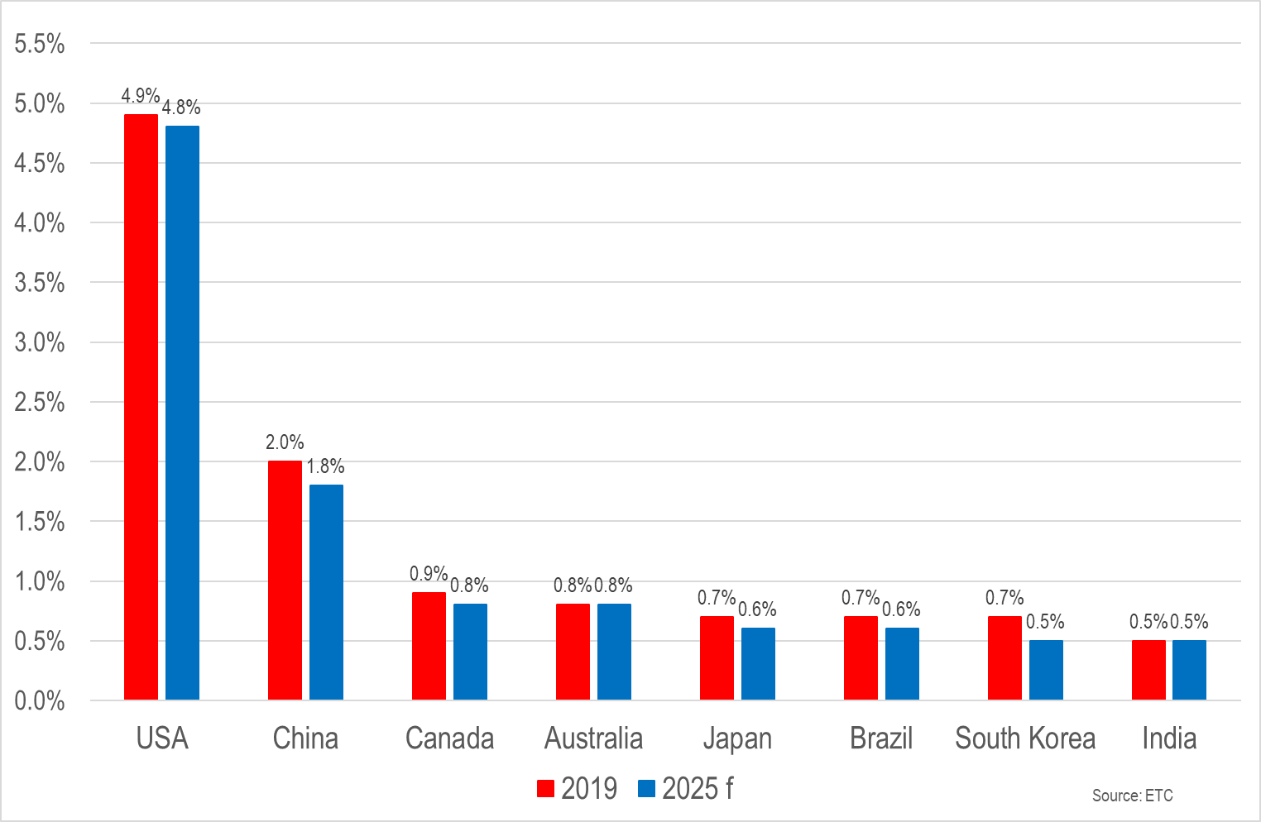
Leading long-haul markets for Europe (share of international arrivals)

Slide 8
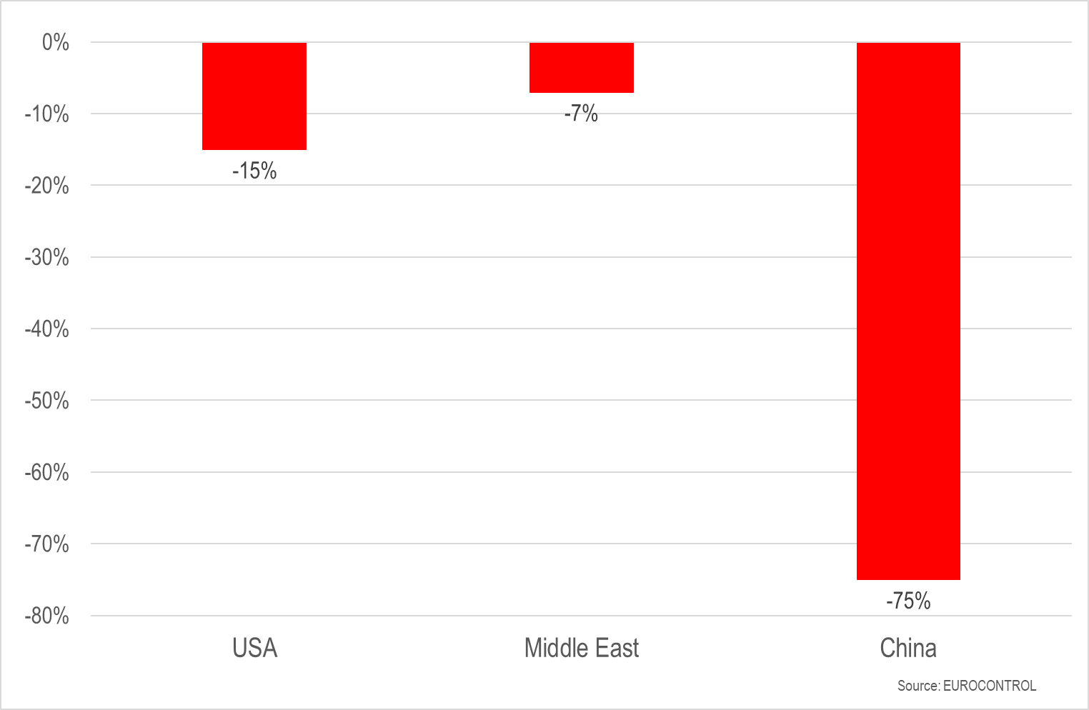
International flights compared with 2019 (6-12 October)

Slide 9
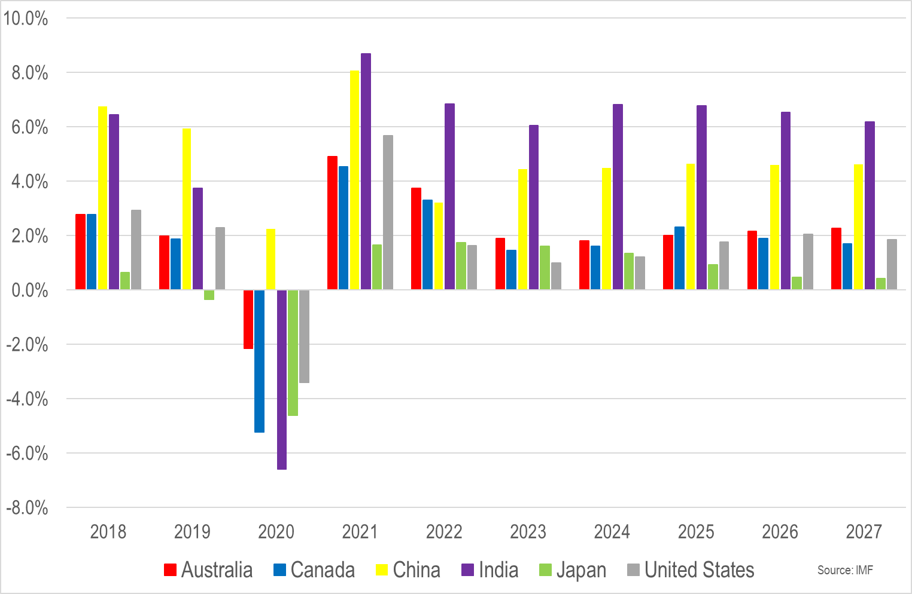
Economic growth: trends and forecasts (% change in GDP)
Each new wave of forecasts sees near-term expectations revised downwards

Slide 10
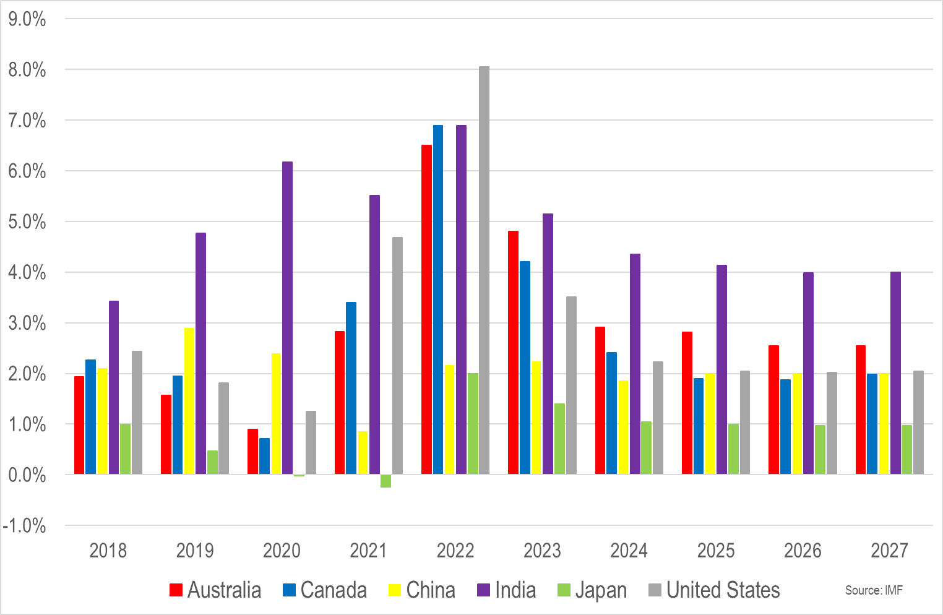
The re-emergence of inflation (% change in consumer price inflation)
Energy costs have grabbed headlines, but rising food prices are equally troubling
The average cost of air tickets in Europe in July 2022 was 15% higher in real terms than was the case in July 2019

Slide 11
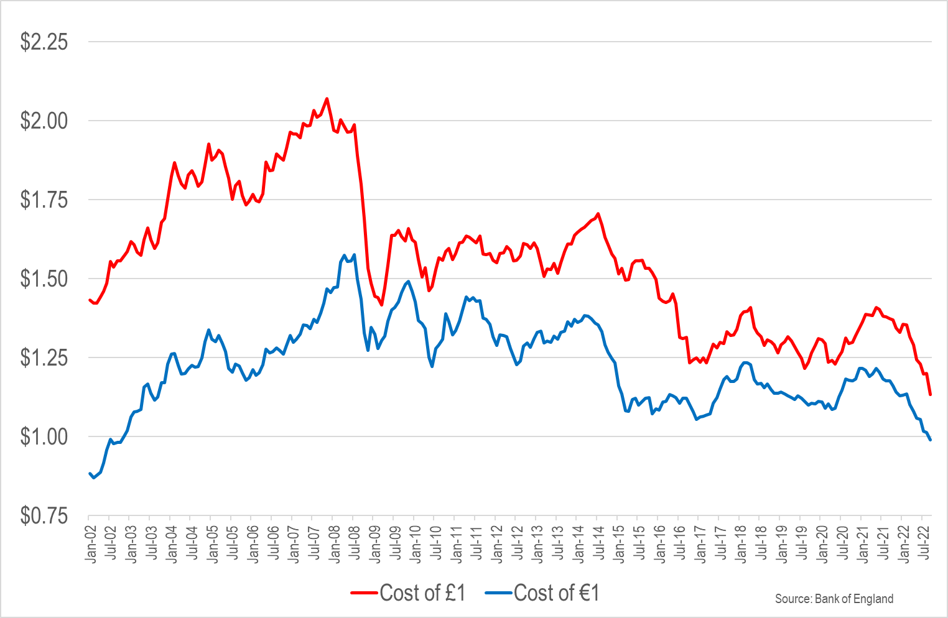
US$ exchange rates – good news and bad news

Slide 12
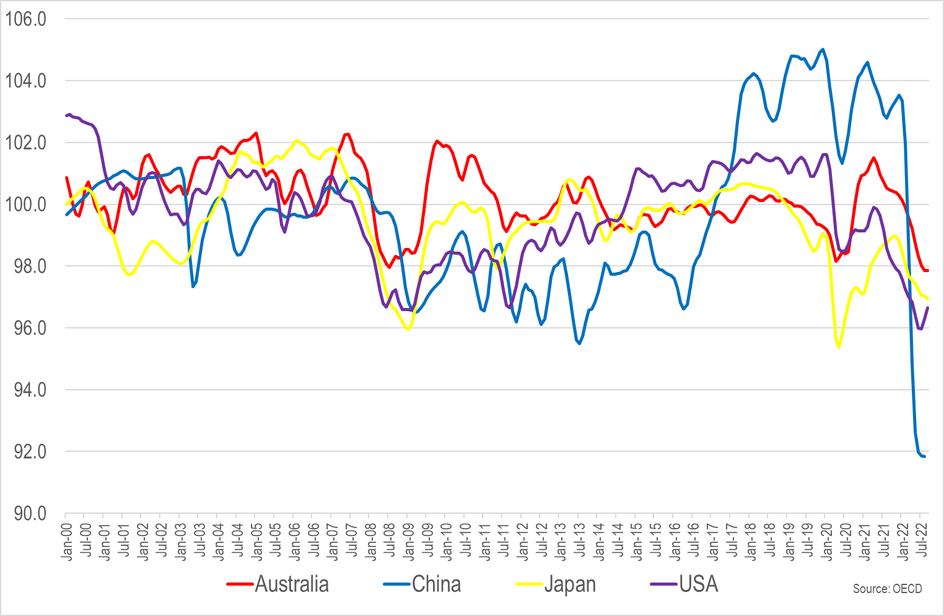
Consumer confidence (long-term average = 100)

Slide 13
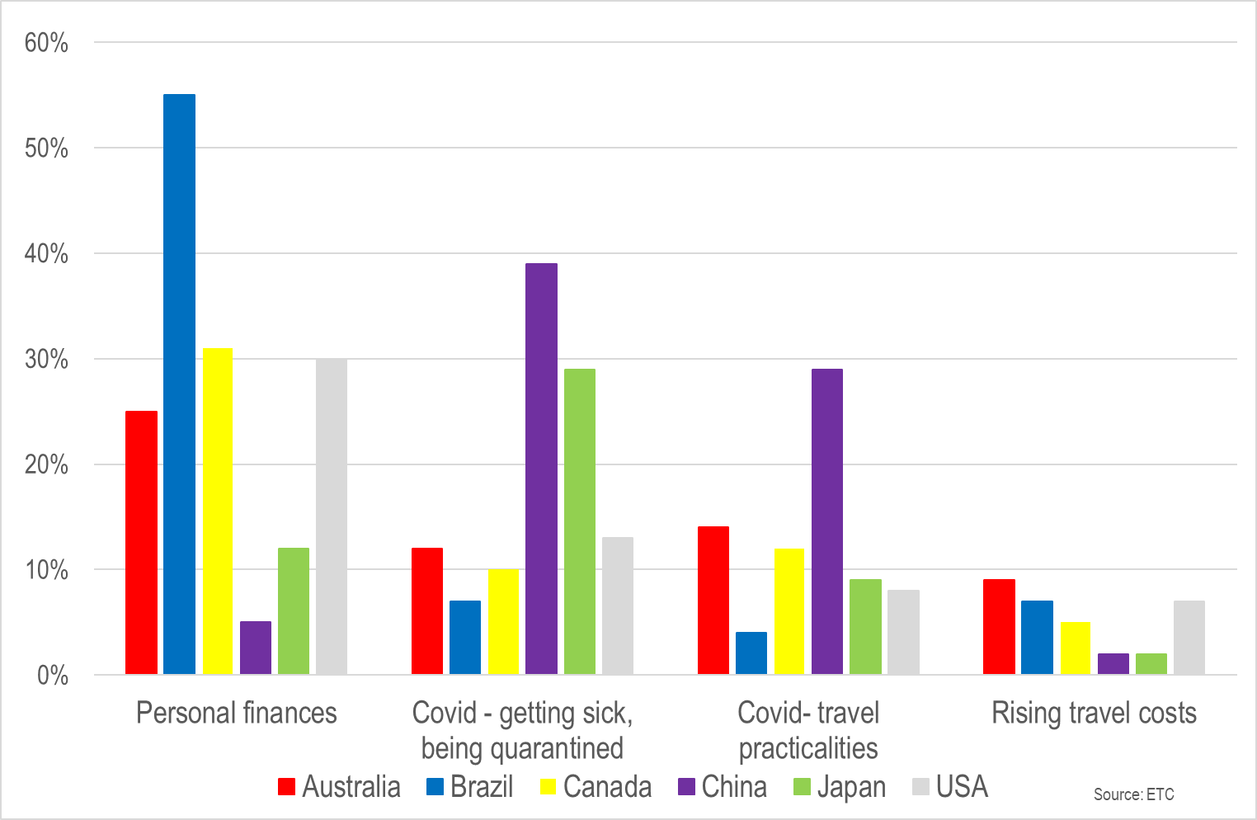
Perceived barriers to long-haul travel

Slide 14
Covid-19
We can say with a good deal of confidence, though not complete certainty, that Europe is in the post-lockdown era
The same is not true in China, which in 2019 was the world’s most valuable outbound source market
What we cannot say is that we are in the post-Covid era
The upcoming winter poses the risk of a so-called ‘twindemic’, with a resurgence in Covid-19 infections alongside a widely circulating seasonal flu virus for the first time since 2019
The upshot could negatively impact demand, but equally impact the supply-side if there is above-average sickness among the visitor economy workforce

