Slide 1
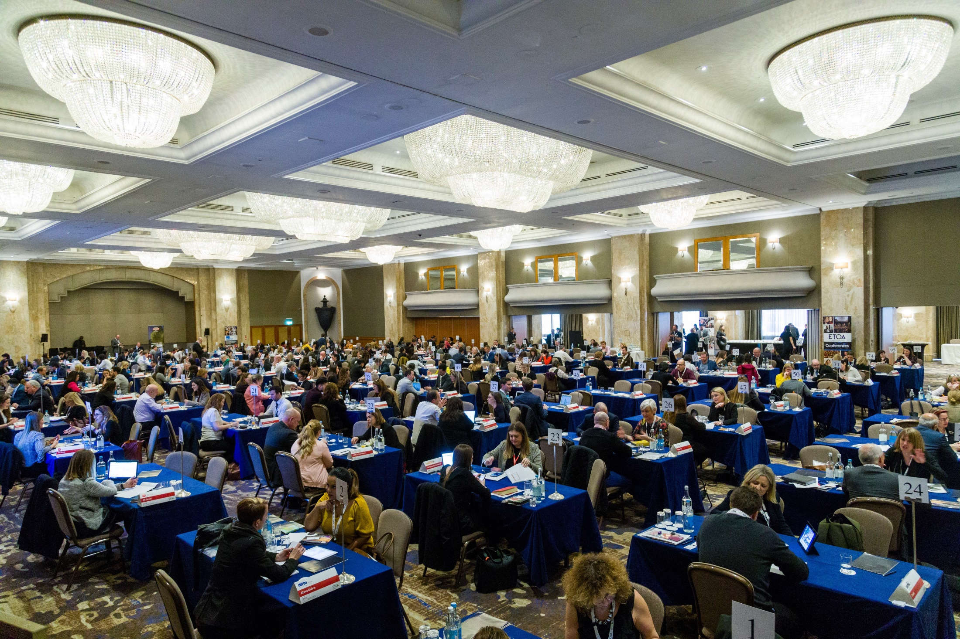
BETTER TOURISM
IN EUROPE
GEM 2022 | Industry Briefing
www.etoa.org

Slide 2
GEM 2022 Industry Briefing
Thursday 3rd November, ZSL London
www.etoa.org
Notes:
Right click -> Format Background -> Replace it with your picture ☺

Slide 3
Agenda
Welcome
2022: Taking stock and looking beyond
It’s all about People
Coffee break
European Project Showcase
Climate Action: Risk and Reality
www.etoa.org
Notes:
Right click -> Format Background -> Replace it with your picture ☺

Slide 4
Welcome
Jennifer Tombaugh, Chairman, ETOA / President, Tauck
Tom Jenkins, CEO, ETOA
www.etoa.org
Notes:
Right click -> Format Background -> Replace it with your picture ☺

Slide 5
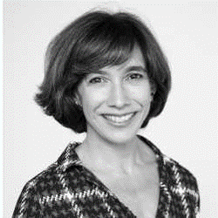
Jennifer Tombaugh, Chairman, ETOA
www.etoa.org
Notes:
Right click -> Format Background -> Replace it with your picture ☺

Slide 6
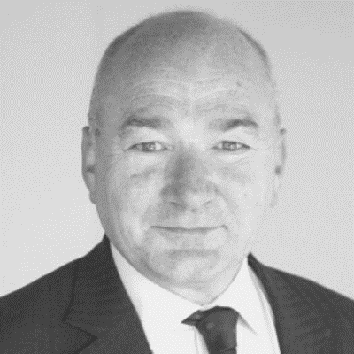
Tom Jenkins, CEO, ETOA
www.etoa.org
Notes:
Right click -> Format Background -> Replace it with your picture ☺

Slide 7
GERMAN VAT
Announcement of 29th January 2021
Non- EU operators will have to register, reclaim input tax and charge output tax on German services
Cost burden
Big competitive difference between operators
  buying directly from suppliers (reclaiming input)
  buying through an EU intermediary (no input reclamation)
    Double tax renders EU based wholesalers uncompetitive
www.etoa.org
Notes:
Right click -> Format Background -> Replace it with your picture ☺

Slide 8
GERMAN VAT
Implementation
Deferred until 1st January 2022
Deferred again to 1st January 2023
We are working to get another delay
www.etoa.org
Notes:
Right click -> Format Background -> Replace it with your picture ☺

Slide 9
GERMAN VAT
26th October 2022: European Commission
Review of the VAT rules applicable to travel and tourism
Wide review
Everything on table
Taxing transport (including air)
Getting rid of VAT retail reclaims
Copying German model for entire EU
Tax on the process of exporting EU services
www.etoa.org
Notes:
Right click -> Format Background -> Replace it with your picture ☺

Slide 10
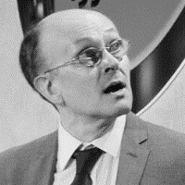
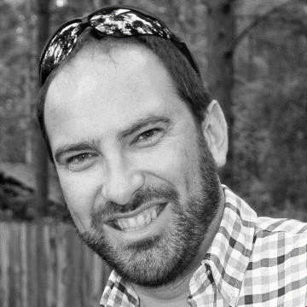

2022: Taking stock & looking beyond
Moderator: Rachel Read, Director of Insight, ETOA
David Edwards, Tourism Insight Expert, ETOA
Gordon Clark, VP Business Development - Brands, Retailers & Media, Forward Keys
Jerome Wise, VP Enterprise Clients, Amadeus
www.etoa.org
Notes:
Right click -> Format Background -> Replace it with your picture ☺

Slide 11
Taking stock & looking beyond
David Edwards, Tourism Insight Expert, ETOA
www.etoa.org
Notes:
Right click -> Format Background -> Replace it with your picture ☺

Slide 12
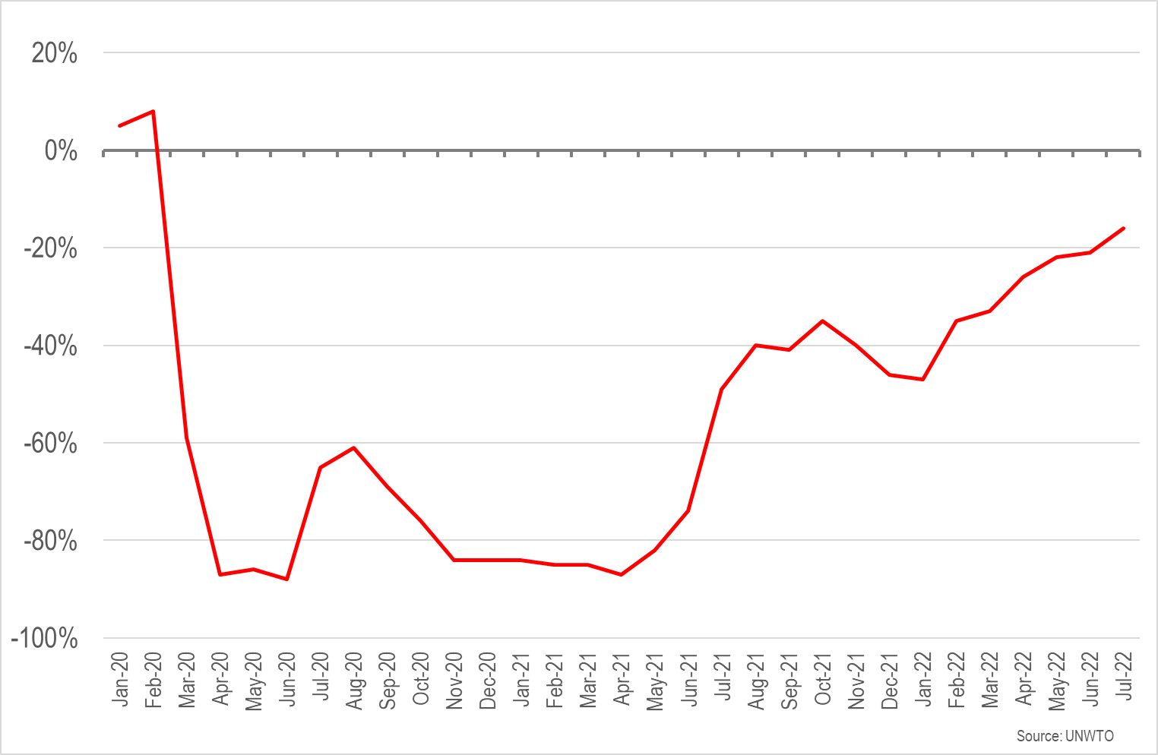
International arrivals in Europe compared with 2019
The shortfall was just 16% in July

Slide 13
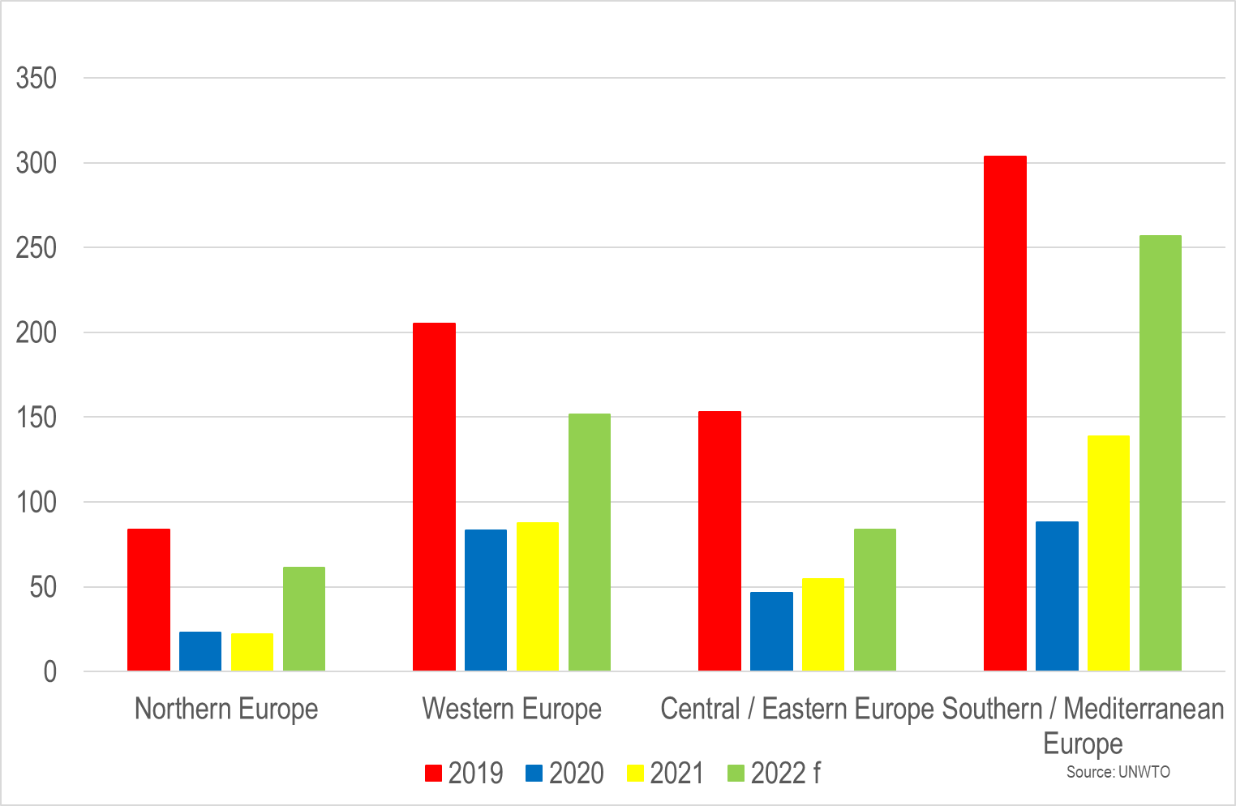
International arrivals in Europe’s regions (millions)
2022 forecast assumes year-to-date performance will apply across the full year, in reality Q4 should outperform Q1

Slide 14
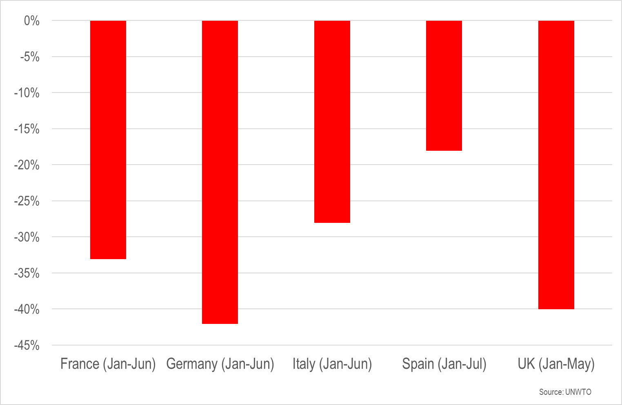
International arrivals in selected destinations (year-to-date)

Slide 15
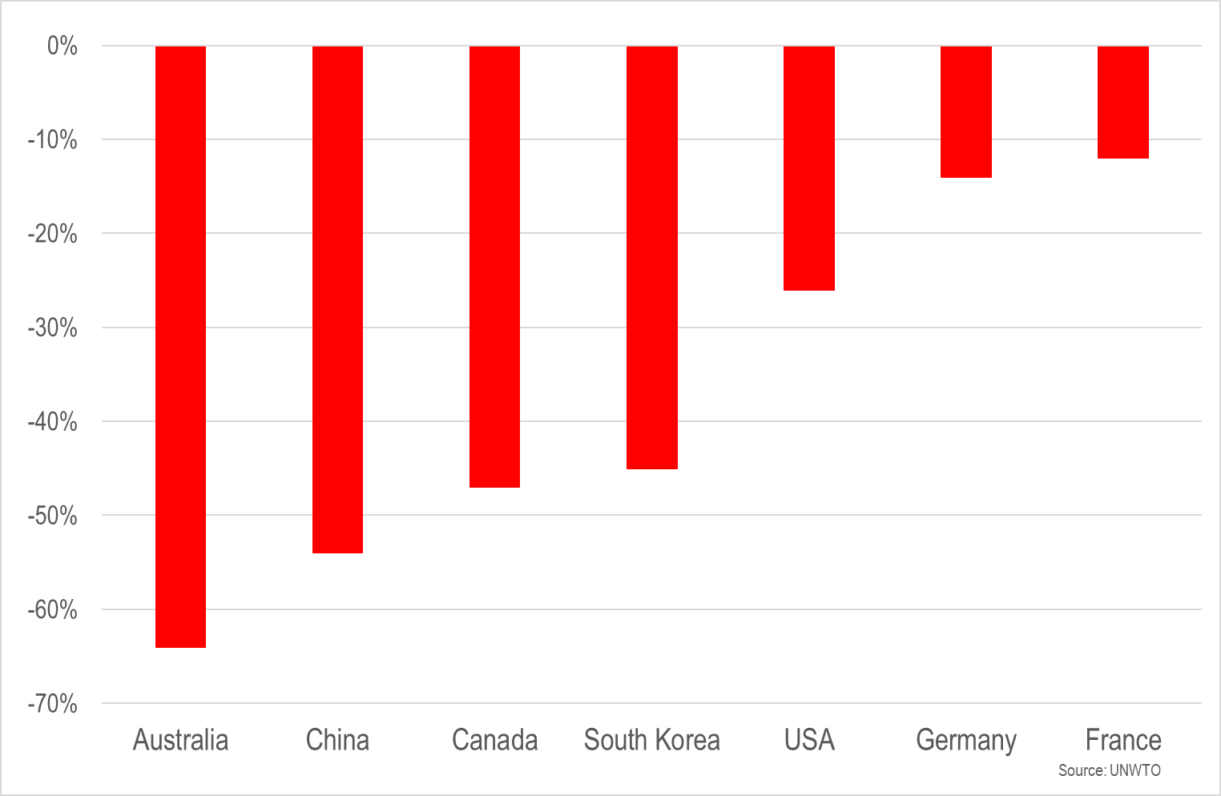
Spend on outbound travel compared with 2019 (year-to-date)
The wave of pent-up demand from some markets may have already reached the shore, but that from other markets remains far out at sea

Slide 16
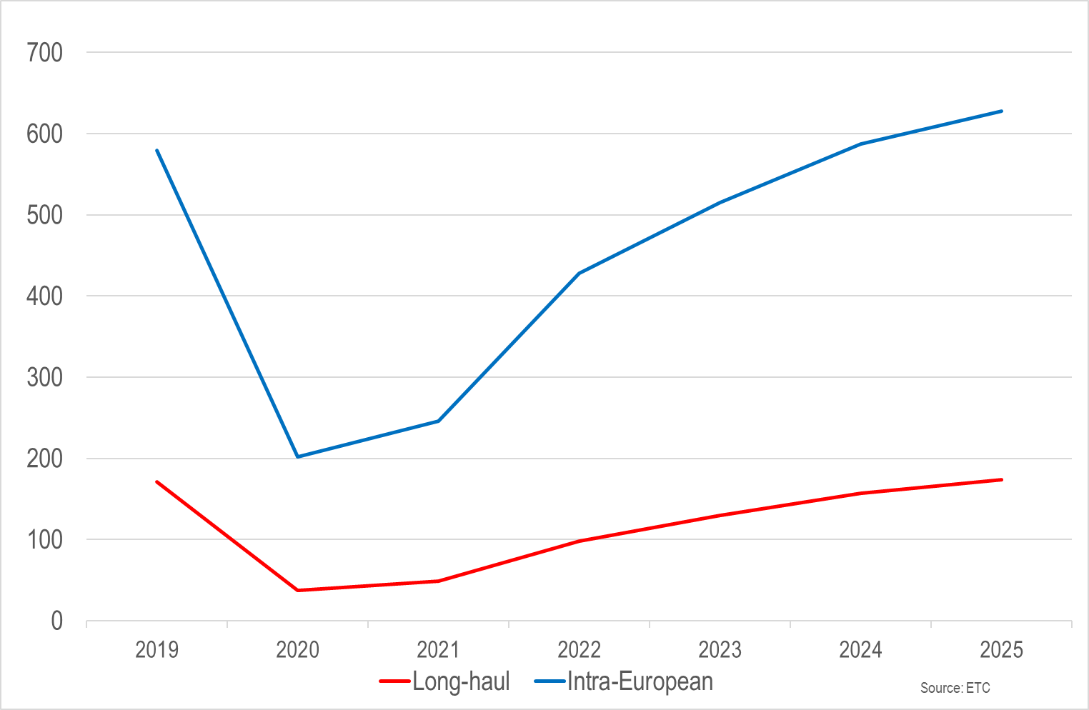
International arrivals in Europe: trends and forecasts (millions)
Full recovery is still forecast to be two to three years away
Volume is dominated by short-haul, but long-haul visitors typically spend two to three times as much per visit

Slide 17
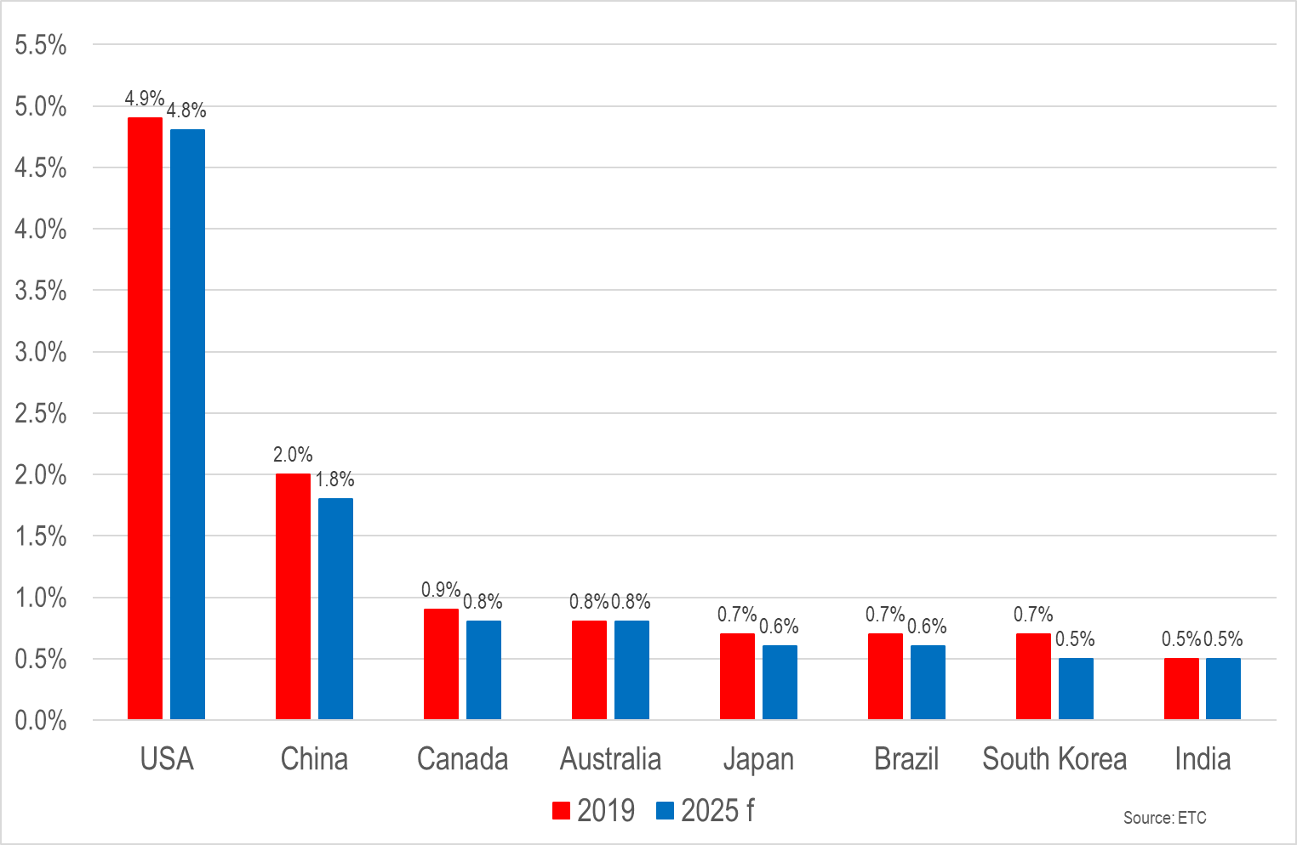
Leading long-haul markets for Europe (share of international arrivals)

Slide 18
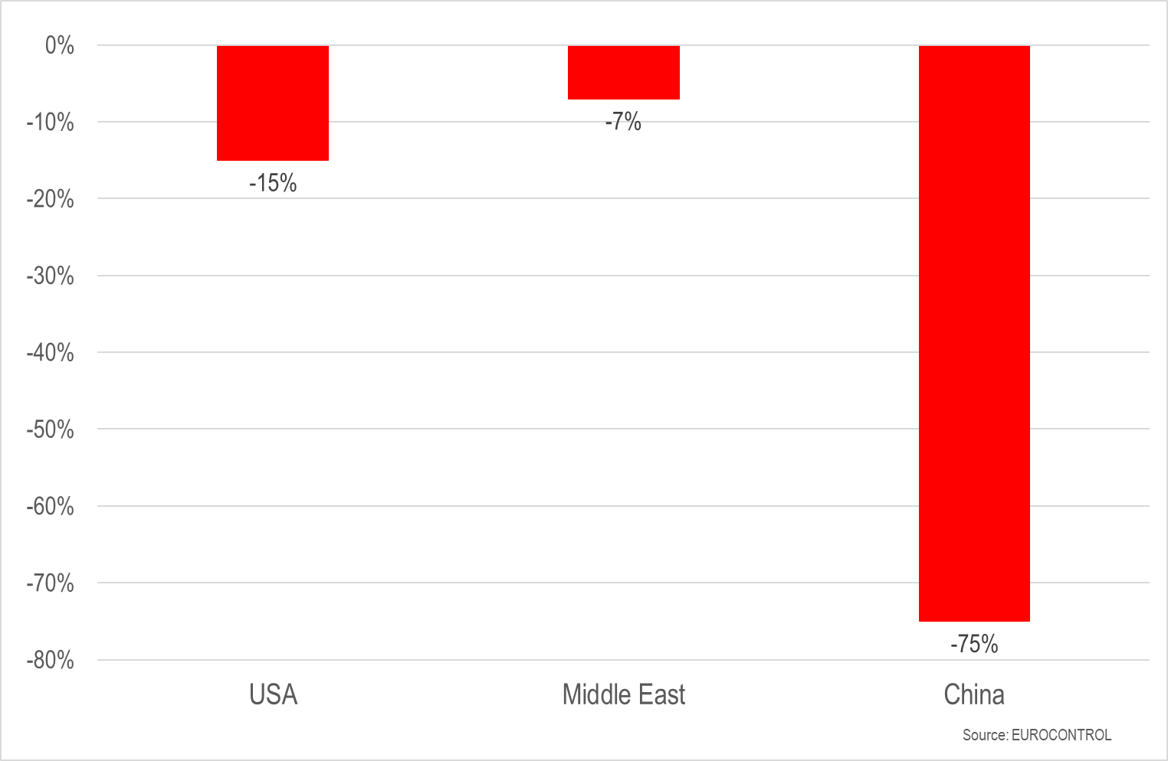
International flights compared with 2019 (6-12 October)

Slide 19
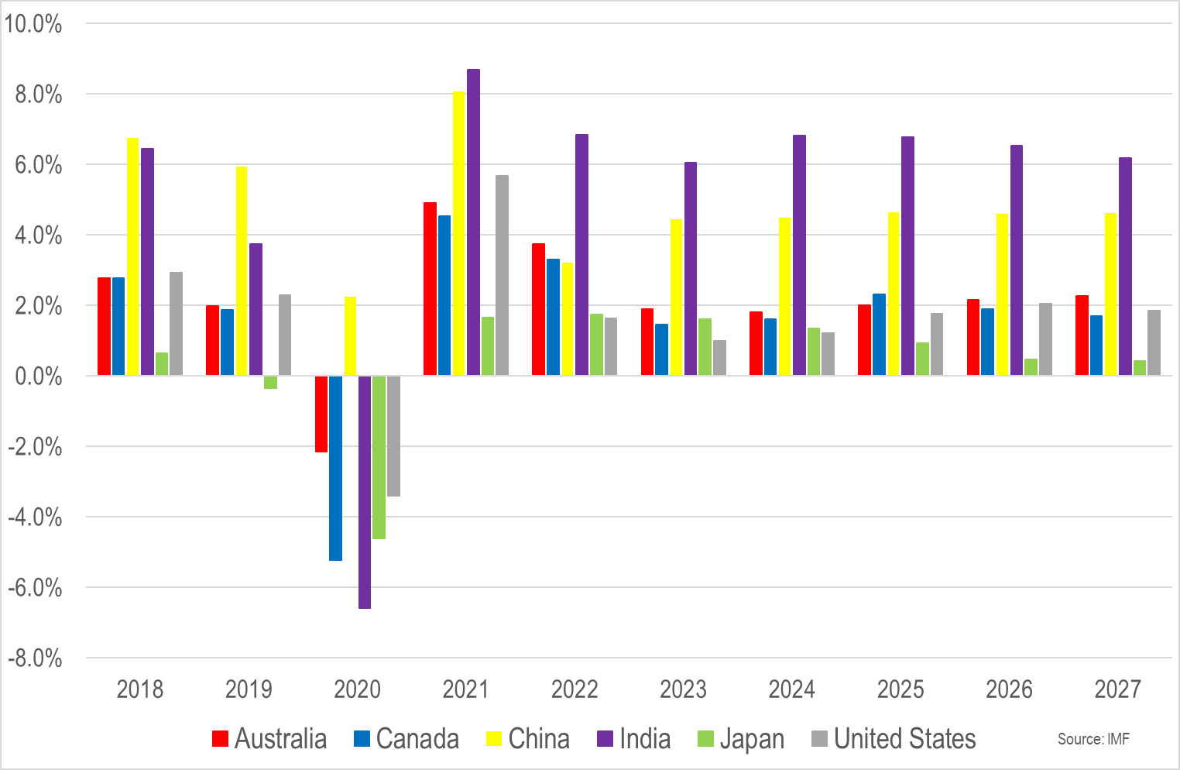
Economic growth: trends and forecasts (% change in GDP)
Each new wave of forecasts sees near-term expectations revised downwards

Slide 20
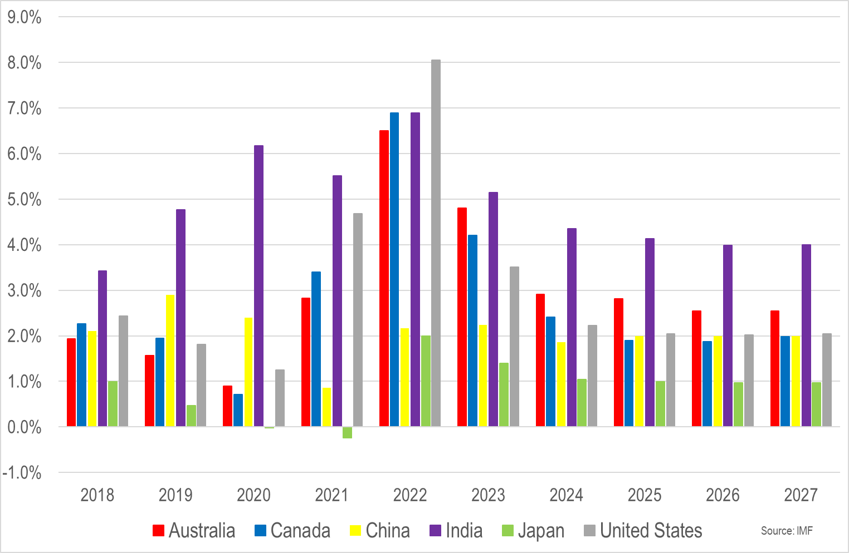
The re-emergence of inflation (% change in consumer price inflation)
Energy costs have grabbed headlines, but rising food prices are equally troubling
The average cost of air tickets in Europe in July 2022 was 15% higher in real terms than was the case in July 2019

Slide 21
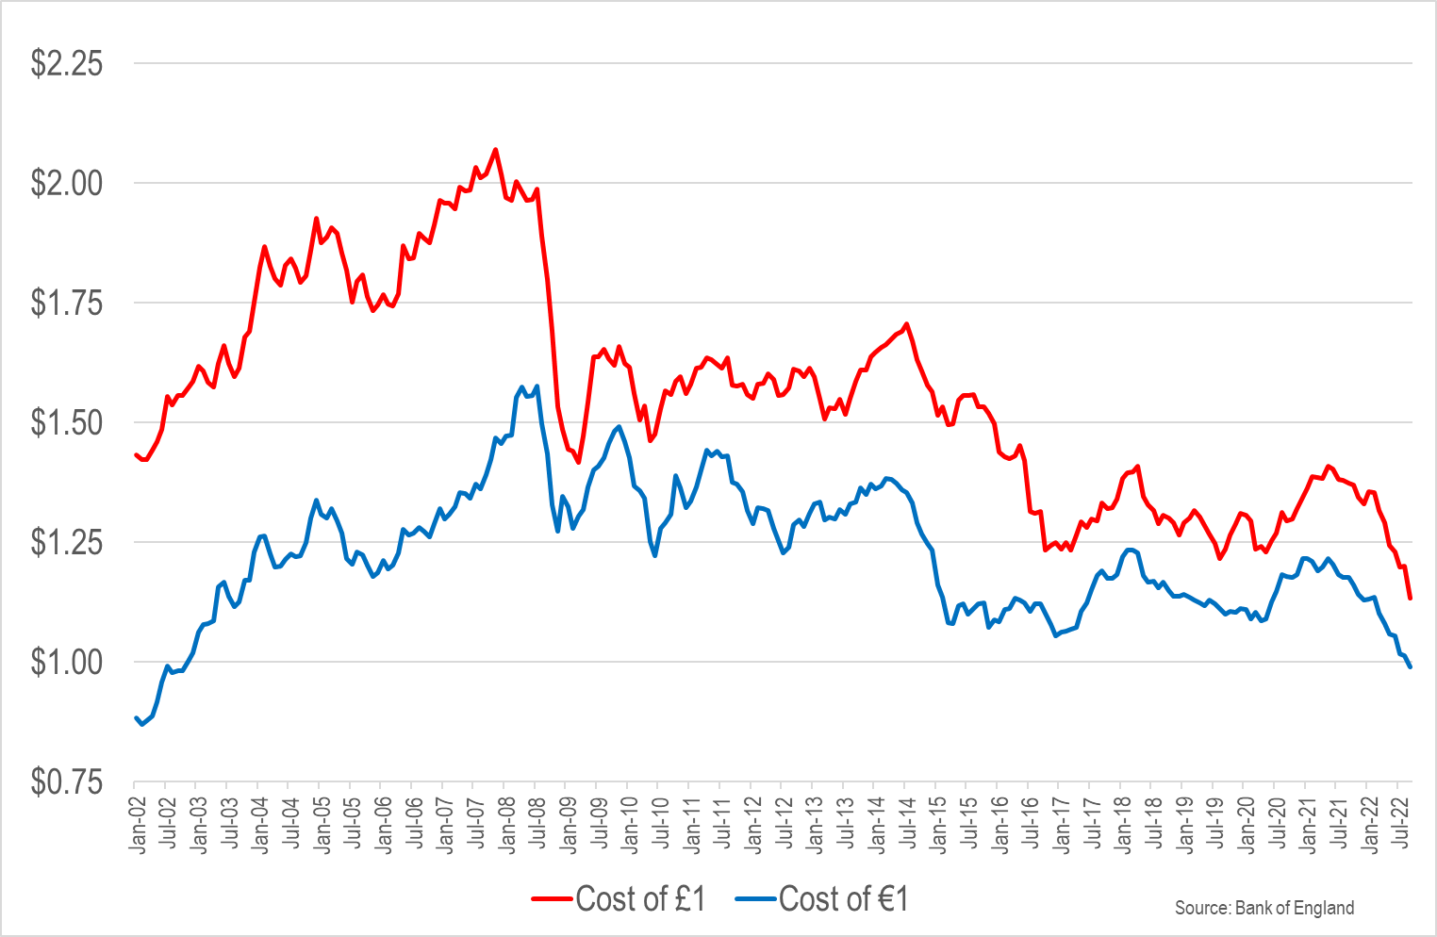
US$ exchange rates – good news and bad news

Slide 22
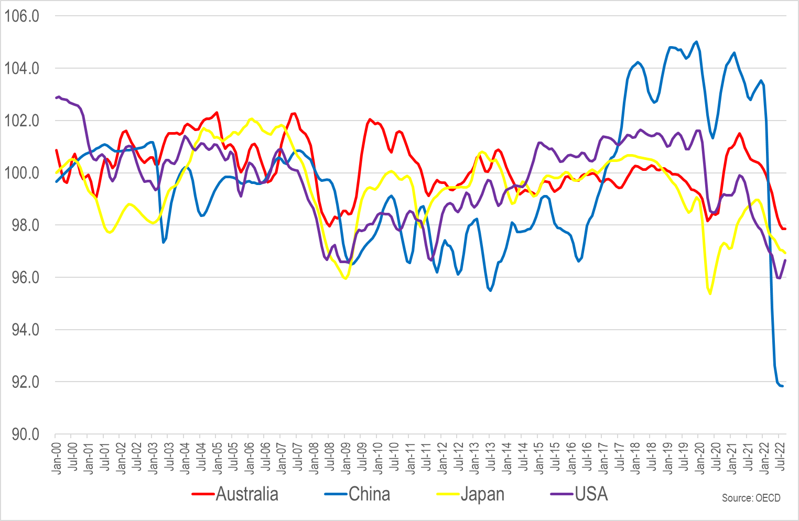
Consumer confidence (long-term average = 100)

Slide 23
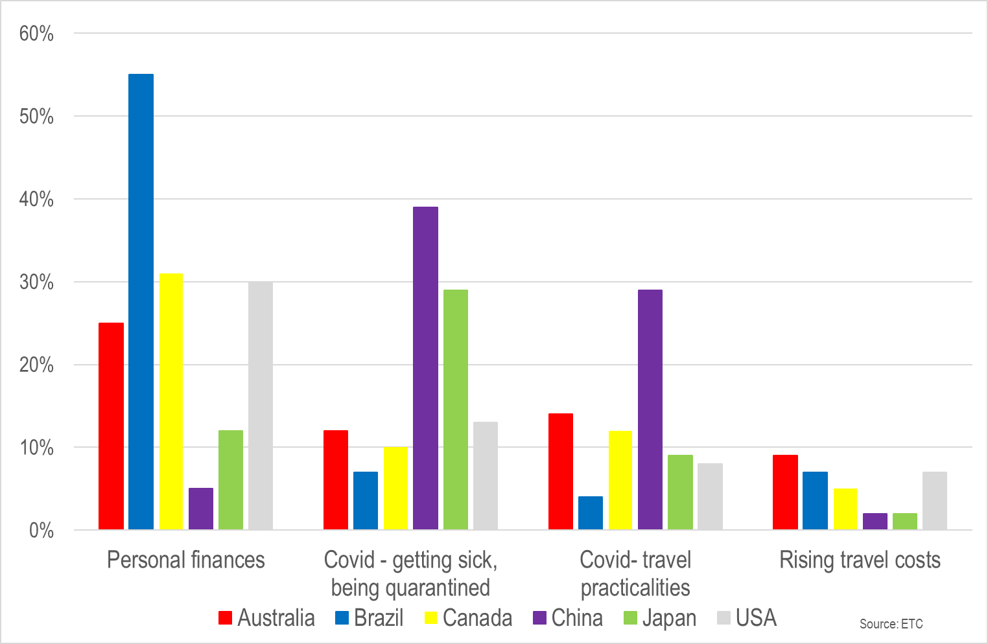
Perceived barriers to long-haul travel

Slide 24
Covid-19
We can say with a good deal of confidence, though not complete certainty, that Europe is in the post-lockdown era
The same is not true in China, which in 2019 was the world’s most valuable outbound source market
What we cannot say is that we are in the post-Covid era
The upcoming winter poses the risk of a so-called ‘twindemic’, with a resurgence in Covid-19 infections alongside a widely circulating seasonal flu virus for the first time since 2019
The upshot could negatively impact demand, but equally impact the supply-side if there is above-average sickness among the visitor economy workforce

Slide 25
2022: Taking stock & looking beyond
Moderator: Rachel Read, Director of Insight, ETOA
David Edwards, Tourism Insight Expert, ETOA
Gordon Clark, VP Business Development - Brands, Retailers & Media, Forward Keys
Jerome Wise, VP Enterprise Clients, Amadeus
www.etoa.org
Notes:
Right click -> Format Background -> Replace it with your picture ☺

Slide 26
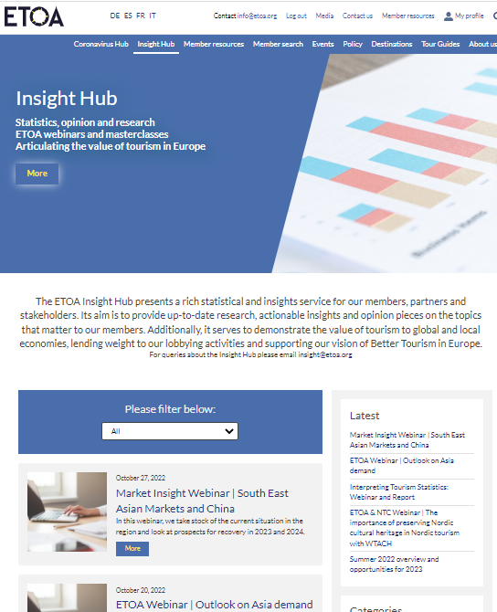
Insight Hub
ETOA.ORG/INSIGHT
Notes:
Right click -> Format Background -> Replace it with your picture ☺

Slide 27


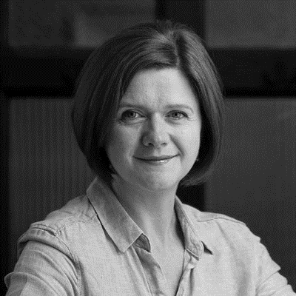
It’s all about People
Moderator: Sean Taggart, Commercial Director, ETOA
Paul Devoy, CEO, Investors in People
Kate Nicholls, Chief Executive, UKHospitality
Mark Mayhew, Chairman, Tour Partner Group
www.etoa.org
Notes:
Right click -> Format Background -> Replace it with your picture ☺

Slide 28
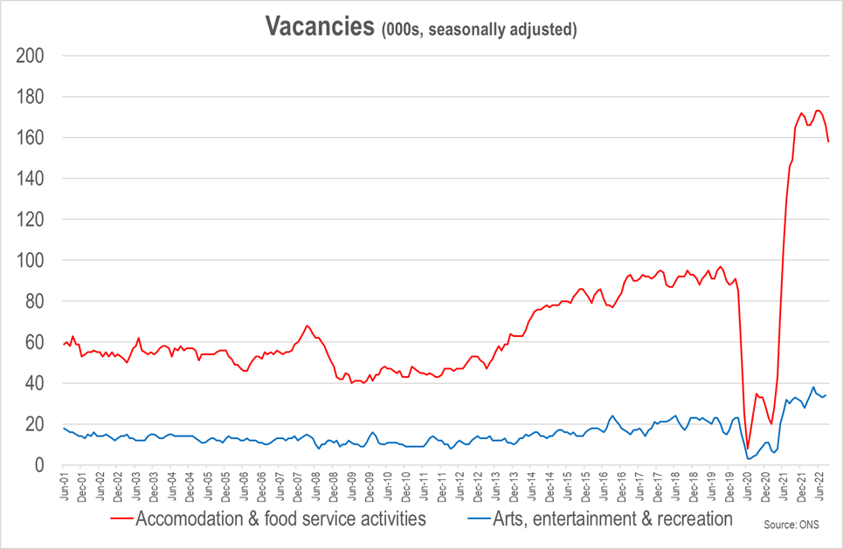
Vacancies in sectors aligned with tourism 2001-22 (000s)
The number of vacancies has started to show tentative signs of a decline, but not as a result of proactive policy interventions, rather it hints at cost of living pressures denting consumer demand
00
Notes:
Right click -> Format Background -> Replace it with your picture ☺

Slide 29
It’s all about People
Moderator: Sean Taggart, Commercial Director, ETOA
Paul Devoy, CEO, Investors in People
Kate Nicholls, Chief Executive, UKHospitality
Mark Mayhew, Chairman, Tour Partner Group
www.etoa.org
Notes:
Right click -> Format Background -> Replace it with your picture ☺

Slide 30
Coffee Break
www.etoa.org
Notes:
Right click -> Format Background -> Replace it with your picture ☺

Slide 31
European Project Showcase
Arran Wiltshire, Director of Events, ETOA
www.etoa.org
Notes:
Right click -> Format Background -> Replace it with your picture ☺

Slide 32




European Projects
PANTOUR
PANTOUR
EURO-EMOTUR
SUSTOUR
The Pact for Next Tourism Generation Skills (PANTOUR) is a consortium that seeks to boost innovation through cooperation to develop activities, strengthen partnerships and produce resources to implement the Blueprint for Sectoral Skills Development in Tourism in Europe.
EURO-EMOTUR project represents an opportunity to change the game in the European tourism industry through the digital transition.
This Project Connects The SMEs With Digital Technologies Through People (Tourists’ Emotions) And Knowledge (Labs).
Promoting sustainability among the European tour operator sector through a business led approach. SUSTOUR aims to foster the capacities and skills to improve sustainable management and open up new market opportunities.
www.etoa.org

Slide 33
PANTOUR Consortium
CEHAT (Spain) - Confederacion Espanola De Hoteles Yalojamientes Turisticos Asociacion
Ruraltour - European Federation of Rural Tourism
Federturismo Confindustria (Italy) - La Federazione Nazionale dell'Industria dei Viaggi e del Turismo del sistema Confindustria
VIMOSZ (Hungary) - Hungarian Hospitality Employers' Association
Landurlaub Mecklenburg-Vorpommern (Germany)
Gestlabor Hostelería (Spain)
DSFT (Germany) - Deutsches Seminar für Tourismus
TU Dublin (Ireland) - Technological University Dublin
BUas (Netherlands) - Breda University of Applied Sciences
University Of The Aegean (Greece)
SAMK University (Finland) - Satakunta University
Zangador Research Institute (Bulgaria)
www.etoa.org

Slide 34
The Pact for Next Tourism Generation Skills – 4 Years
Short Term Impacts
Medium Term Impacts
Building public access knowledge on new trends on the job market, new occupational job profiles, and impacts of Covid on the workforce
Dissemination of research and partnerships between industry and educational level to build alliances targeting reskilling and upskilling the workforce.
Design of innovative and digital tools that will be available for the training, skilling and reskilling of the workforce in the EU level.
Design of an action plan, to be delivered at the end of the Project and that will provide a roadmap for reskilling and upskilling in the sector
Construction of partnerships with local level training providers and delivery of work-based training content to skill the workforce in the sector.
Long Term Impacts
Building of a strong and resilient workforce prepared for the challenges of the future.​
Growth of new jobs related to digital, green and social skills and the increasing demand and supply of jobs in the sector.​
The positive effects on the environment of new strategies on training and skilling the workforce, supporting the Green Deal and preparing the population to a better future.​
The positive effects of the skilling in the sector, building new relationships between employees and employers and​ setting a positive work environment, attracting more talents to the industry.​
www.etoa.org

Slide 35
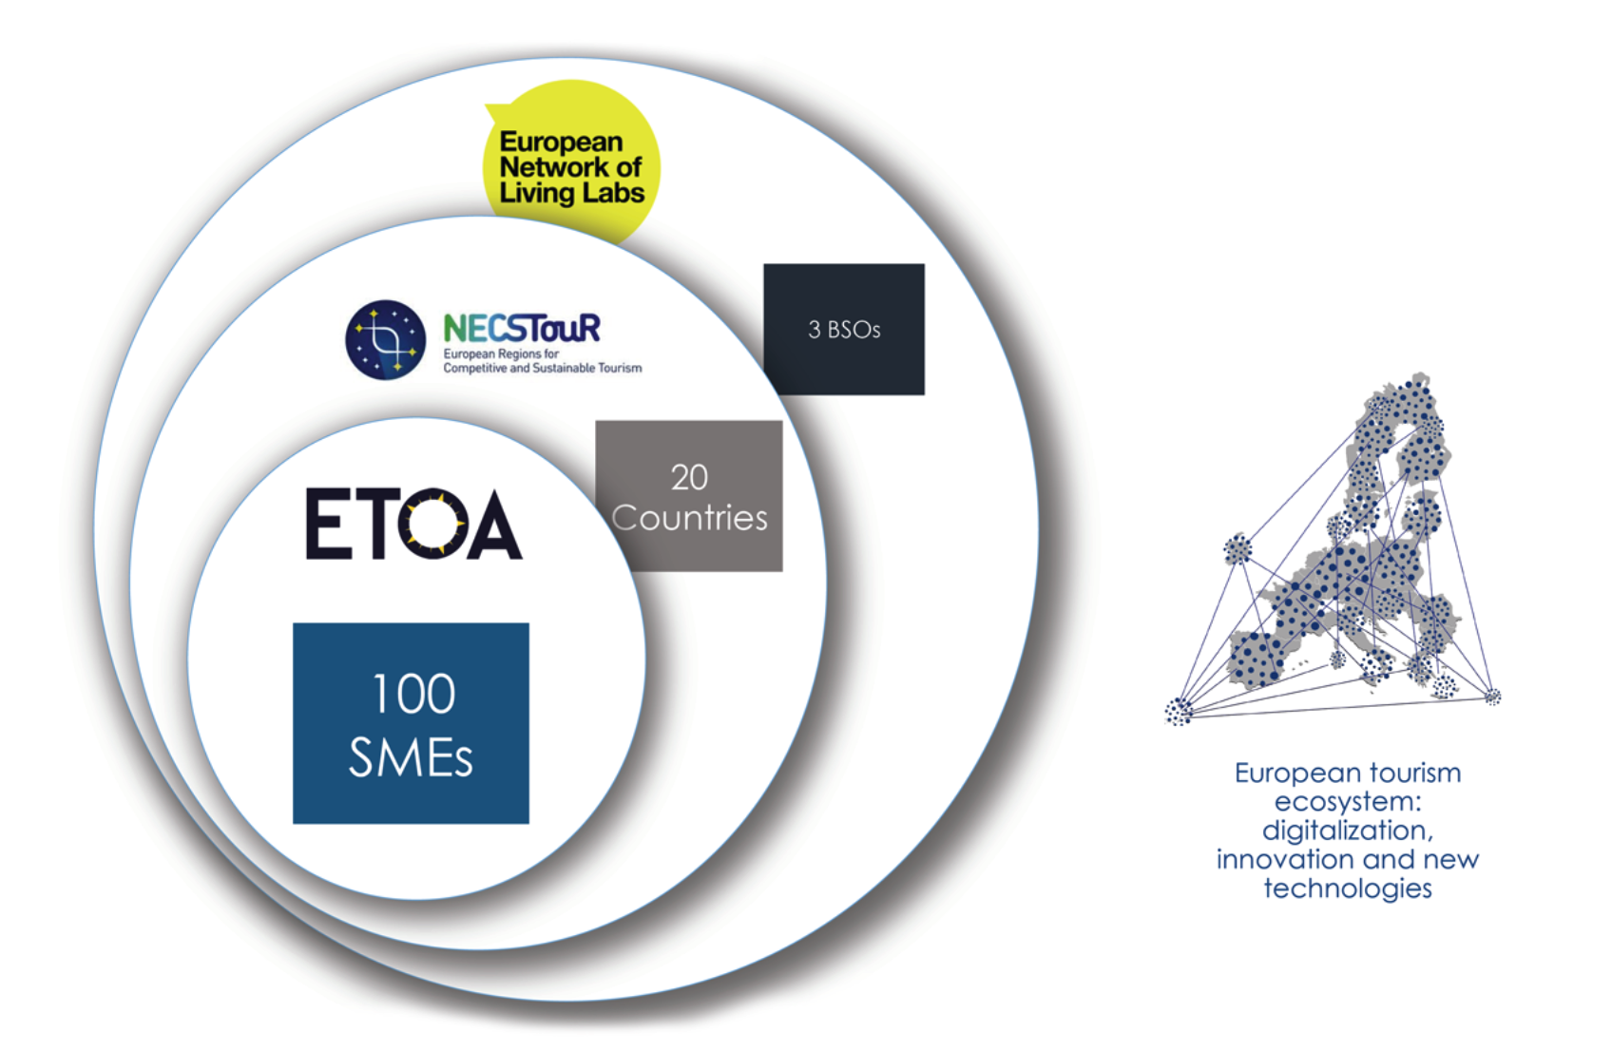
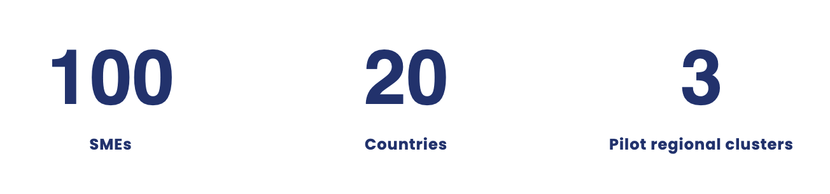
EURO-EMOTUR
Improve competencies in direct marketing (B2C and B2B), using neuromarketing techniques:
Virtual Reality
Augmented reality
Face coding
Eye tracking
EEG (electroencephalogram)
www.etoa.org

Slide 36
EURO-EMOTUR
Funding up to a maximum of €10,000 in value per SME (average €4,000), that can be used:
For coaching and mentoring sessions for a feasibility study and ad-hoc recommendations
Payment for required licenses and services to access new technology solutions
Compliance adaptation services in the field of digital solutions such as virtual reality, augmented reality, eye-tracking, face coding, EEG, digital reputation, artificial intelligence.
To attend training programmes for SME tourism professionals
To cover travel, registration, and accommodation costs to attend courses and matchmaking events
To cover participation fees for digital-oriented events at EU level
www.etoa.org

Slide 37
SUSTOUR
Promoting sustainability among the European tour operator sector through a business led approach
SUSTOUR aims to foster the capacities and skills of 175+ tour operators (SMEs) to implement training, management systems, standards and solutions, which will improve their sustainable management and performance and open up new market opportunities. SMEs from all EU countries will be invited to benefit from SUSTOUR. Focus countries include The Netherlands, Germany, Finland, Portugal and Croatia.
www.etoa.org

Slide 38


Climate Action: Risk and Reality
Moderator: Tim Fairhurst, Director of Policy, ETOA
Chris Parkin, Senior Director – Hilton Sales UK & Ireland
Deepa Sutherland, Counsel, Zelle International LLP
www.etoa.org
Notes:
Right click -> Format Background -> Replace it with your picture ☺

Slide 39
Stay Better with Hilton
Chris Parkin, Senior Director – Hilton Sales UK & Ireland
www.etoa.org
Notes:
Right click -> Format Background -> Replace it with your picture ☺

Slide 40
Climate Action: Risk and Reality
Moderator: Tim Fairhurst, Director of Policy, ETOA
Chris Parkin, Senior Director – Hilton Sales UK & Ireland
Deepa Sutherland, Counsel, Zelle International LLP
www.etoa.org
Notes:
Right click -> Format Background -> Replace it with your picture ☺

Slide 41
Zelle International LLP
Deepa Sutherland, Counsel, Zelle International LLP
www.etoa.org
Notes:
Right click -> Format Background -> Replace it with your picture ☺

Slide 42
Climate Action: Risk and Reality
Moderator: Tim Fairhurst, Director of Policy, ETOA
Chris Parkin, Senior Director – Hilton Sales UK & Ireland
Deepa Sutherland, Counsel, Zelle International LLP
www.etoa.org
Notes:
Right click -> Format Background -> Replace it with your picture ☺

Slide 43

Workshops 2023
www.etoa.org/events
Notes:
Right click -> Format Background -> Replace it with your picture ☺

