Slide 1
ETOA
European Travel Marketplace
North America 2022
Student & Youth Market Recovery
March 2, 2022

Slide 2

PRESENTER
https://cdn-dielh.nitrocdn. https://cdn-dielh.nitrocdn.com/bCjNIFGxhjYIUoSrOetEZItUURcvCFxl/assets/static/optimized/rev-ede4d42/wp-content/uploads/2018/03/Tom.jpgcom/bCjNIFGxhjYIUoSrOetEZItUURcvCFxl/assets/static/optimized/rev-ede4d42/wp-content/uploads/2018/03/Tom.jpg
Tom Jenkins
CEO
ETOA

Slide 3

PRESENTER
CARYLANN ASSANTE, CAE
Chief Executive Officer
SYTA & SYTA Youth Foundation

Slide 4
SYTA: WHAT WE DO
for Student & Youth Travel
PROMOTE
the value of travel to social, cultural and educational growth
ADVOCATE
for safe, professional and ethical travel
PROMOTE
the business interests of those engaged in student and youth travel
KEEP UP-TO-DATE
with the latest student group offerings in each destination
MONITOR
federal travel regulations
REPRESENT
the student market at industry-related conferences

Slide 5

Student & Youth Travel
Prior to Pandemic
Student travel was a $185 billion industry and represented 24% of all global tourism annually.
The school group/student sector was 12% of global student industry.
SYTA represented 3 million youth travelers annually.
American Bus Association Research shows 576 million passenger trips - students are 65% of motorcoach travel.

Slide 6


AGE BREAKDOWN OF STUDENT TRAVELLERS
Average
years
Notes:
RESEARCH QUESTION:
What percentage of the students you welcomed in the past academic year (2013/14) were aged (approximately)…?

Slide 7
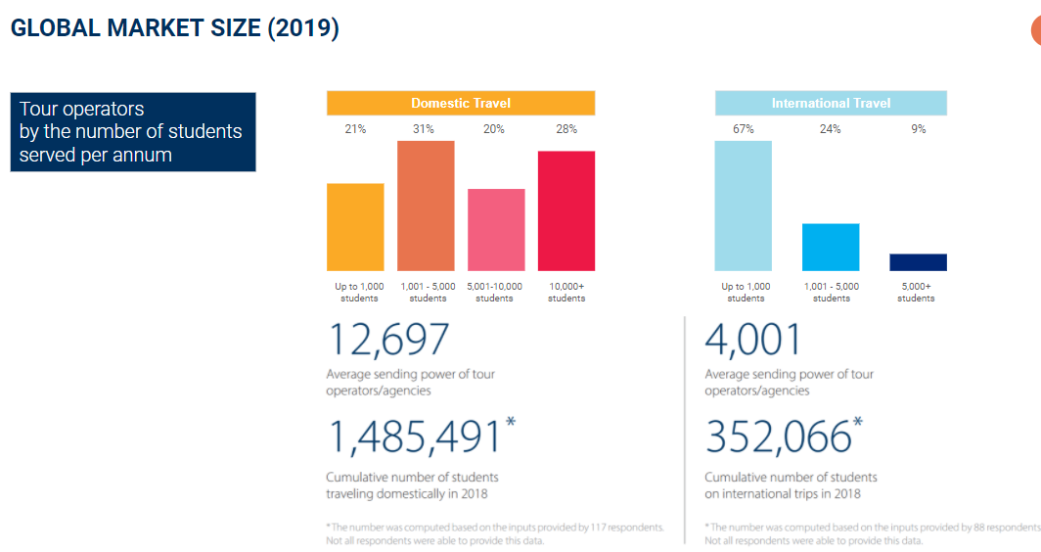

Slide 8
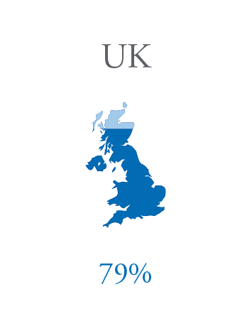
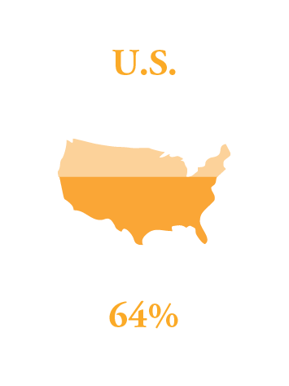
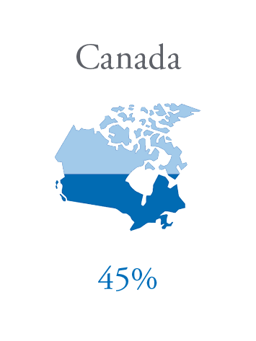
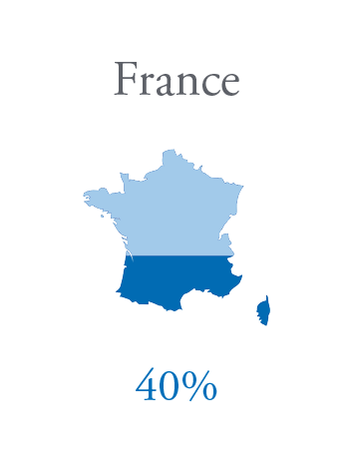
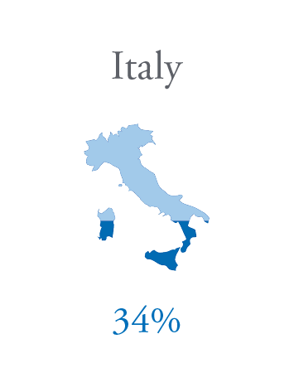
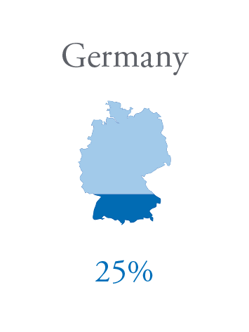
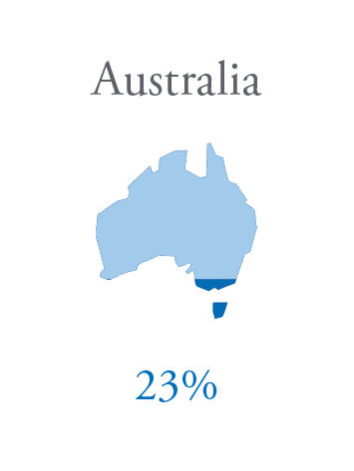
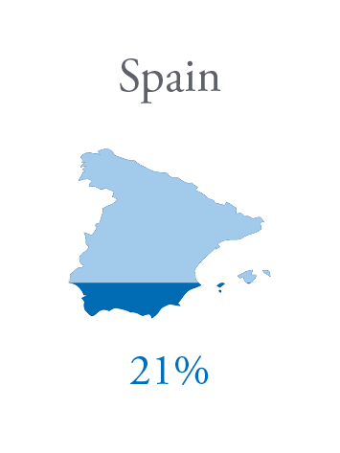
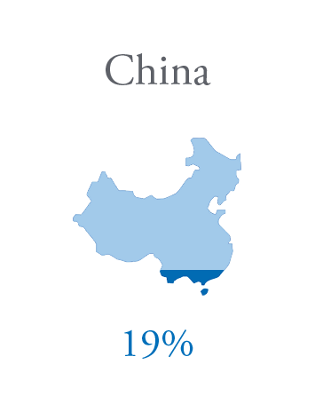
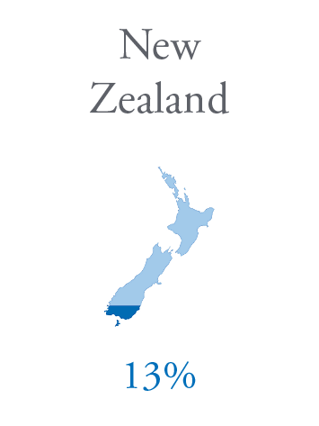
STUDENT GROUP TRAVEL:
MOST PREFERRED DESTINATIONS WORLDWIDE
% - Percentage of tour operators reporting the destination as a top 10 selling market
*Multiple choice question
Notes:
RESEARCH QUESTION:
List the most popular countries your company sent student groups to in the past academic year (2013/14).
English-speaking destinations lead the global ranking of top student group travel destinations. The U.S is the second most popular destination for group trips and 64% of tour operators said it is among the top 10 destinations they send students to.
Furthermore, tour operators from 70 countries predict a steep increase in the demand for student trips to the U.S.

Slide 9
Global Student Travel
Top Destinations for International Students – English Speaking
United States
Great Britain
Canada
Ireland
Australia

Slide 10
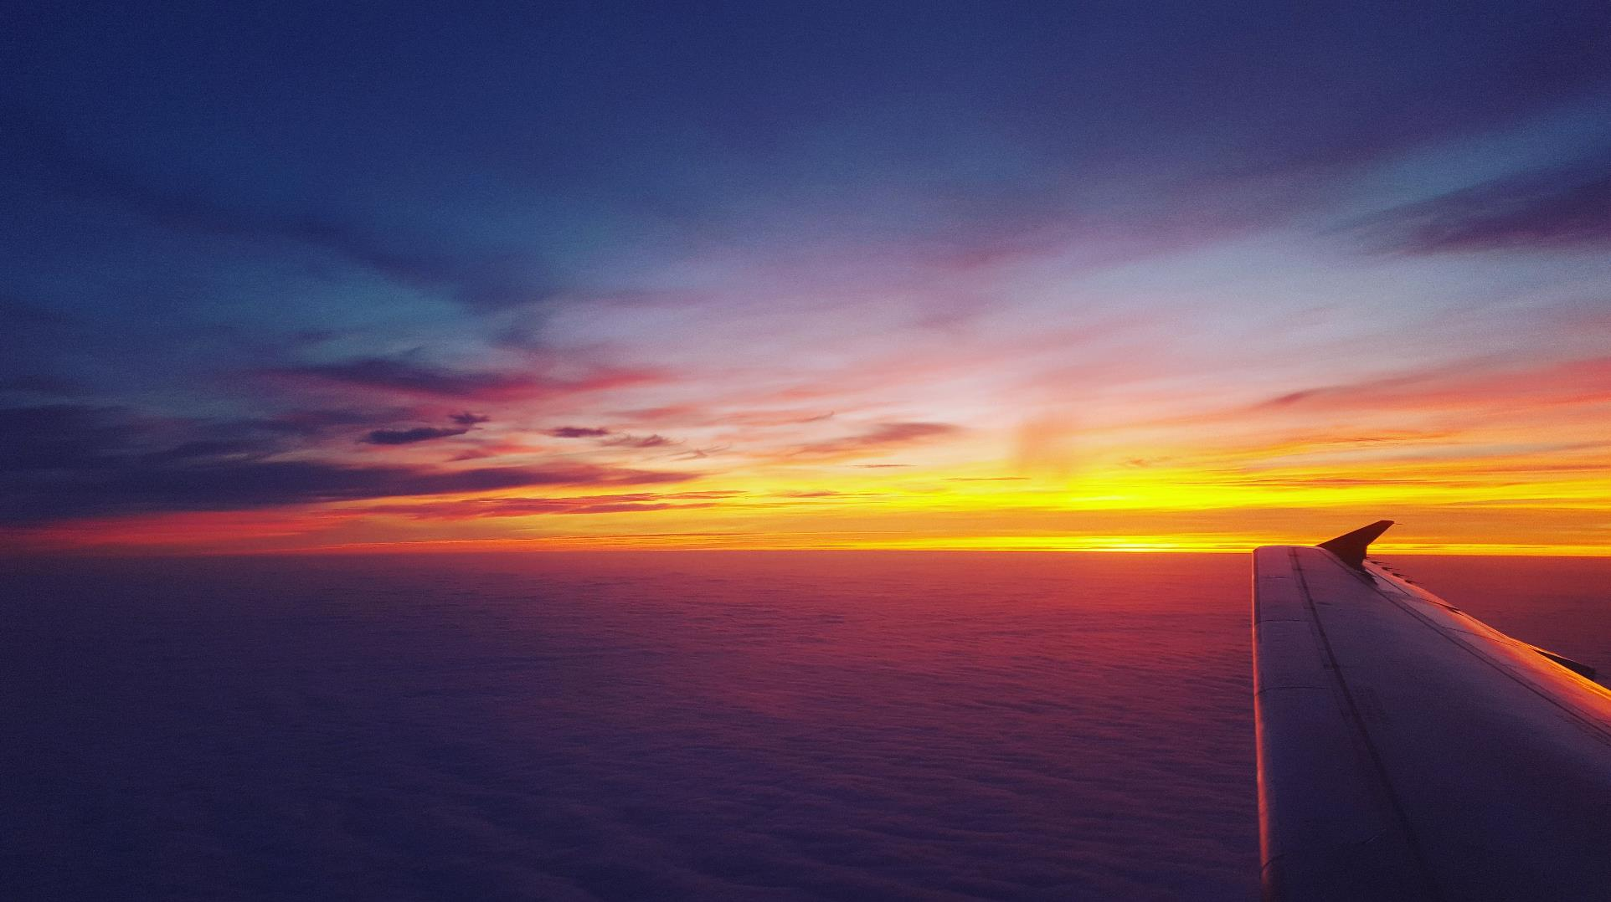


Patrik Pavlacic
Head of Research, BONARD
2020 STUDENT TRAVEL BUSINESS BAROMETER
Expertise in Student Travel Research

Slide 11


INTERNATIONAL TRAVEL
International travel refers to any trip which includes traveling from one country to another.

Slide 12
INTERNATIONAL TRAVEL: 2020 IN REVIEW
Number of students taking an international trip
Predicted industry development for 2020:
Actual industry development in 2020:
+3%
-84%
Based on 56 STOs running international trips.
Source: SYTA & BONARD, 2021
Student Travel Business Barometer | 2020 Survey Results

Slide 13
INTERNATIONAL TRAVEL: MARKET RECOVERY SCENARIOS
Q: What percentage of your 2019 international trip bookings do you anticipate recovering in the following years?
2021
2022
2023
12%
recovery
46%
recovery
77%
recovery
% of respondents
Source: SYTA & BONARD, 2021. Percentage of respondents anticipating the respective recovery levels.
Student Travel Business Barometer | 2020 Survey Results

Slide 14
INTERNATIONAL TRAVEL: 2021 OUTLOOK
Q: What percentage of student trips booked for 2021 are:
2020 postponements
2021
new trips
43%
57%
Source: SYTA & BONARD, 2021
Student Travel Business Barometer | 2020 Survey Results

Slide 15
INTERNATIONAL TRAVEL: 2020 IN REVIEW
Q: What percentage of your customers changed their 2020 international travel plans as follows?
No change, traveled as planned
5%
Changed to another international destination
0%
Changed to a domestic destination
3%
Postponed to 2021
10%
Postponed to 2022
13%
Canceled
67%
Other
2%
Source: SYTA & BONARD, 2021
Student Travel Business Barometer | 2020 Survey Results

Slide 16

INTERNATIONAL TRAVEL: DESTINATION BENCHMARK
Q: Once travel resumes in 2021 or 2022, how much do you expect demand for the following international student travel destinations to change compared to 2019?
Australia
Canada
China
Costa Rica
France
Germany
Ireland
Italy
Spain
UK
USA
-33.8%
+25.2%
-56.6%
-4.5%
-10.3%
-17.4%
+2.4%
-5.5%
-17.8%
-12.3%
+20%
Source: SYTA & BONARD, 2021. Score-based ranking quantifying the current market sentiment (respondents were able to choose values between ‘100’ and ‘-100’).
2020 Student Travel Business Barometer | Deep Dive

Slide 17
2021 STUDENT TRAVEL BUSINESS BAROMETER
Preliminary data

Slide 18
DOMESTIC TRAVEL
Domestic travel refers to any trip conducted within the students’ own country.

Slide 19
2020 TOP 10
U.S. Student Destinations
Boston, MA / Chicago, IL / Cleveland, OH
Los Angeles, CA / Nashville, TN / New Orleans, LA
New York, NY / Orlando, FL / Philadelphia, PA
Washington, DC
SOURCE: Teach & Travel Magazine May 2020

Slide 20
2020 TOP 10
North American Student Destinations
Mexico City / Montreal, QC / Nassau, BS
Niagara Falls, ON / Ottawa, ON
Puerto Rico / Québec City, QC / Toronto, ON
Vancouver, BC / Winnipeg, MB
SOURCE: Teach & Travel Magazine May 2020

Slide 21
Initial Findings
2021 Completed Trips:
  Orlando
  New York - #1 Preferred US/International
  Washington DC
  Boston
  Nashville

Slide 22
Initial Findings
2022 Planned Trips:
  Orlando
  New York - #1 Preferred US/International
  Washington DC
  Tennessee: Nashville/Pigeon Forge/Gatlinburg
  San Antonio
  Branson

Slide 23
DOMESTIC TRAVEL: 2022 OUTLOOK
PRELIMINARY DATA
Q: What percentage of student trips booked for 2022 are:
2020 postponements
2021 postponements
2022
new trips
32%
17%
51%
Source: SYTA & BONARD, 2022

Slide 24

THE NEW WORLD
OF STUDENT TRAVEL
Suppliers & availability
Longer planning time
Increased pricing
Itineraries may look different
Increased COVID safety measures
Last minute requests/changes

Slide 25

CHOOSING A VENDOR
TO PARTNER WITH
Recommended by colleague
Recognized by travel or tour industry association such as SYTA
Proven track record of safety
Crisis management plan in place
Insurance
Signed contract/agreement
Health and safety plan in place
COVID policy
Strong supplier and airline partnerships
Consumer protection policy in place

Slide 26
School Groups on The Road
Lessons Learned for 2021-2022
Smaller Group Sizes: Varies by School
25 to 50 students
Less stops on Itinerary – more time in one place – reduced capacities and safety procedures make it hard to bring large groups
Less switching of hotels – limited service/suite – 3 per room
More outdoor activities and venues
More outdoor dining – less options available
Changes to deposits, refunds and cancellation policies

Slide 27
DECISION TO
DESTINATION
The Student Travel Process

Slide 28
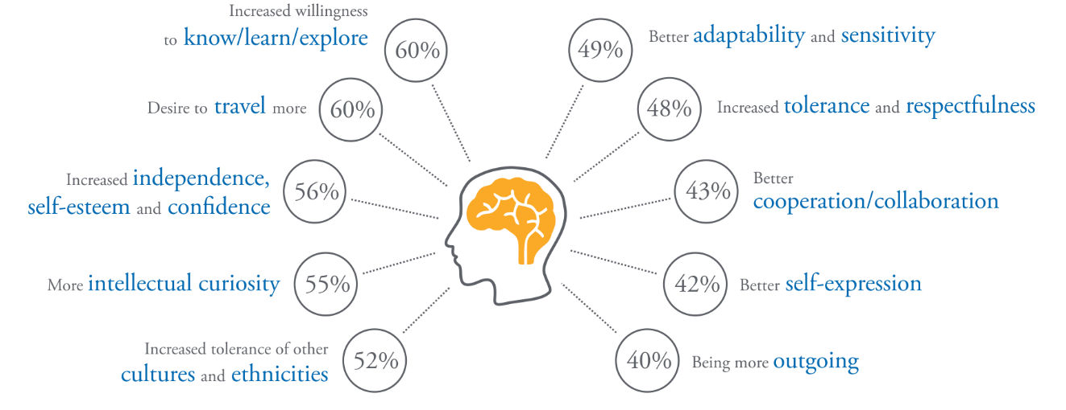
SOCIAL IMPACT OF STUDENT GROUP TRAVEL – TOP 10 EFFECTS
*Multiple choice question
Notes:
RESEARCH QUESTION:
Based on your observations, how have group trips impacted the students you teach?
The profound and instant effect of a travel experience on the performance of young people, inside and outside of an education system, helps boost their personal development. The majority of teachers surveyed (60%) state that student travel triggers a transformation, as a part of which students develop higher ambitions to know, learn and explore. Students are also more aware of themselves and prone to future travel. In addition, learning about new cultures has one of the most effective impacts on young people, as teachers observed that it increases tolerance and respectfulness.

Slide 29
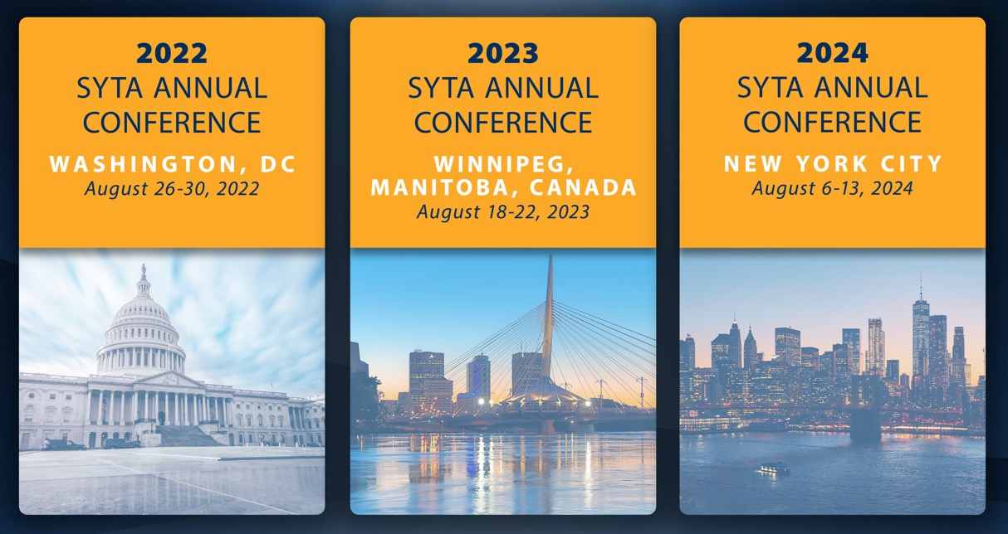
SAVE THE DATE!

Slide 30
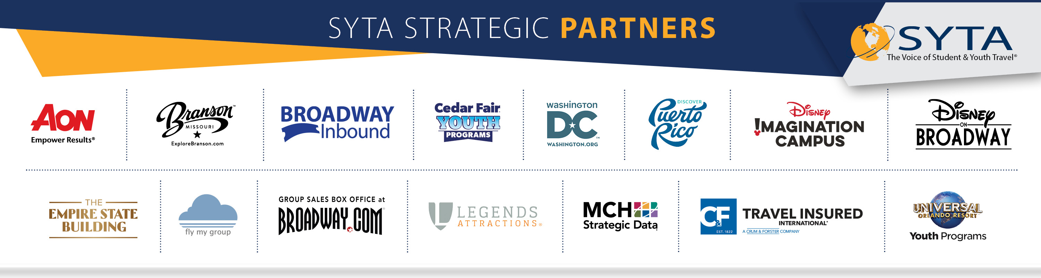

Slide 31
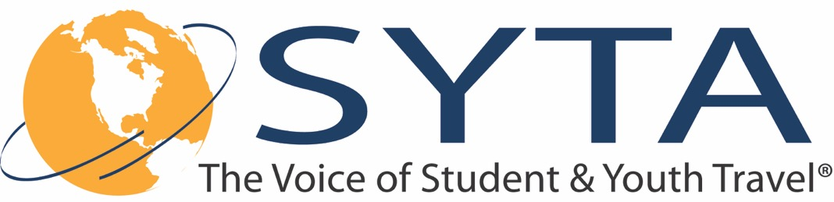
CARYLANN ASSANTE, CAE
Chief Executive Officer, SYTA & SYTA Youth Foundation
cassante@syta.org
www.syta.org

